Slide 1
Lecture 5: Recurrent Neural Networks (1)
Nima Mohajerin
University of Waterloo
WAVELab
nima.mohajerin@uwaterloo.ca
June 29, 2017

Slide 2
Overview
Introduction
Time Delay Feed Forward Neural Networks (TDNNs)
Recurrent Multi Layer Perceptrons (RMLPs)
Real Time Recurrent Learning (RTRL)
Back Propagation Through Time (BPTT)
Vanishing/Exploding Gradient in RNNs
Long-Short-Term-Memory (LSTM)
Gated Recurrent Units
Some applications

Slide 3
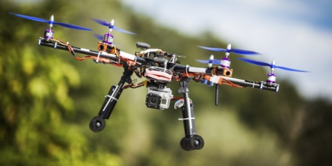


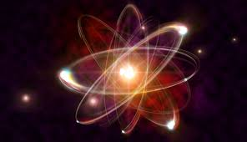

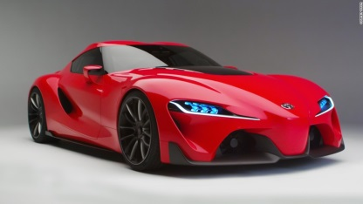
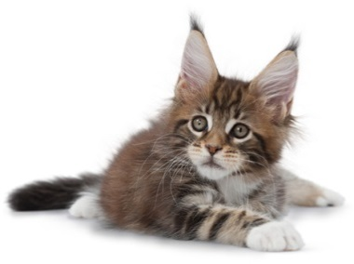

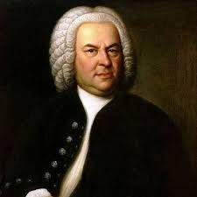
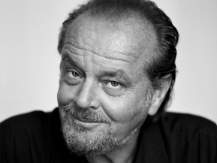

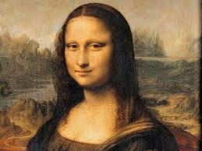


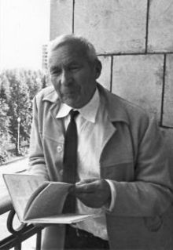

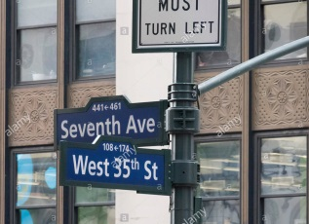
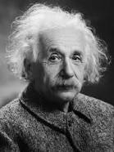
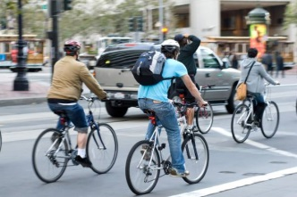
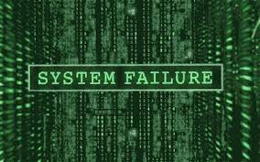

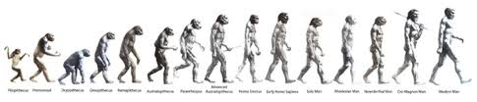
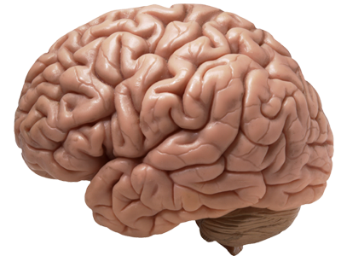
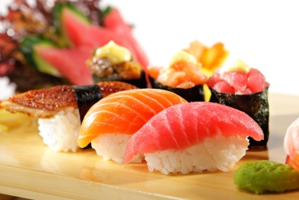
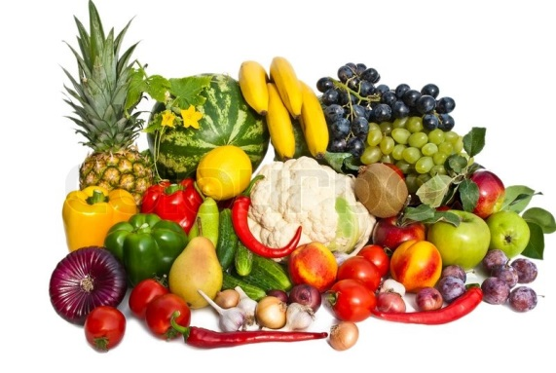
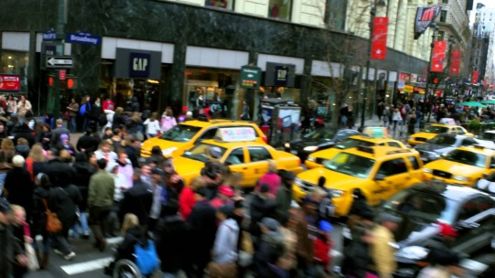

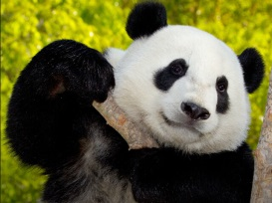
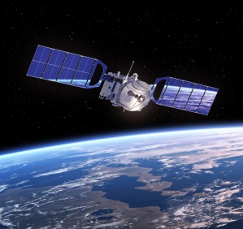

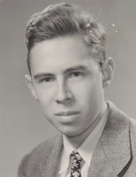



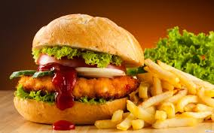


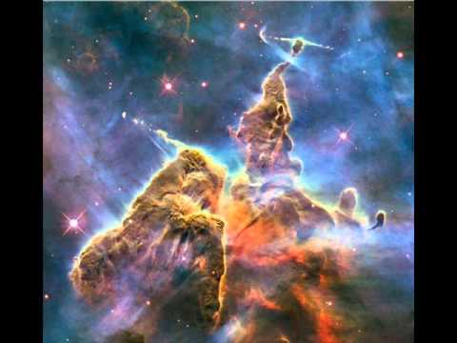
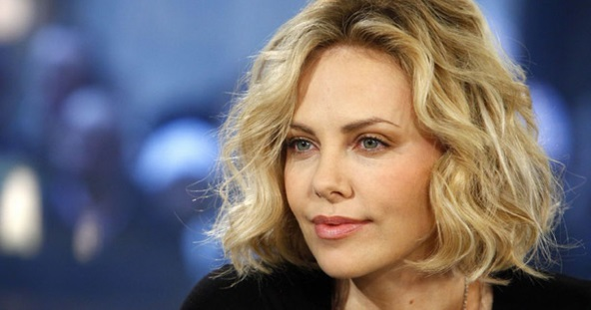

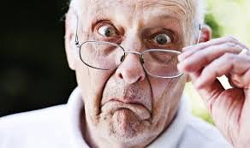

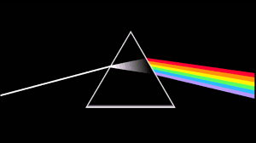
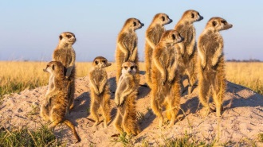
Introduction
Some data have static nature, e.g., images

Slide 4
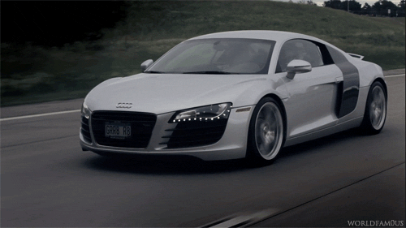
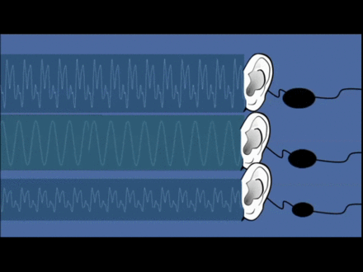
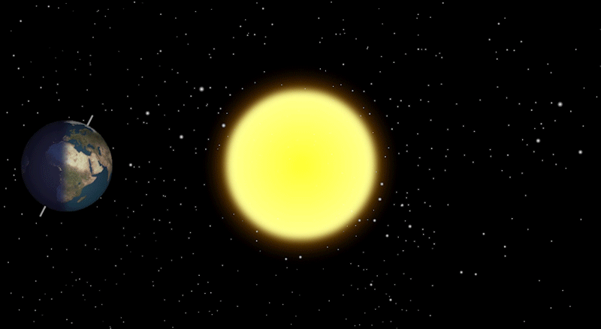
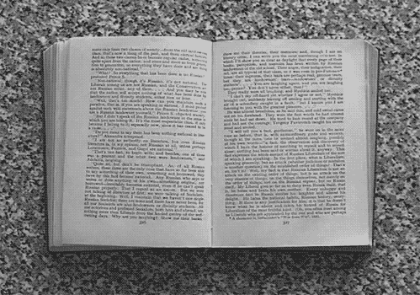
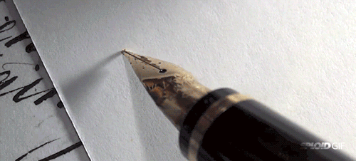
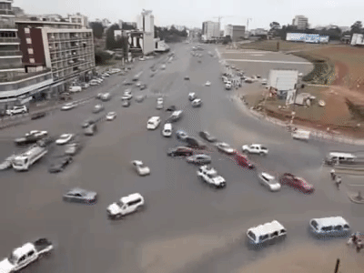
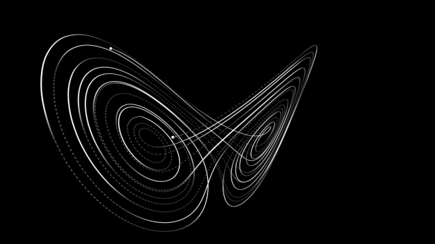
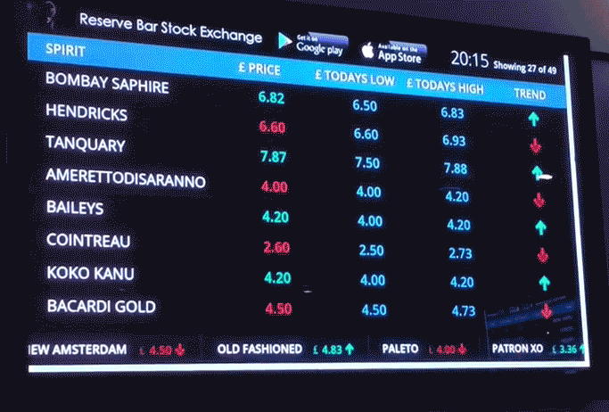
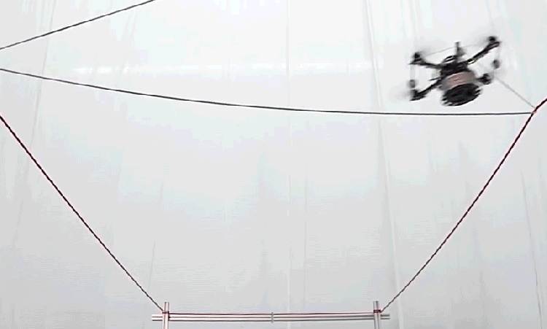
Sequences and Sequential Information
Some other have sequential properties

Slide 5
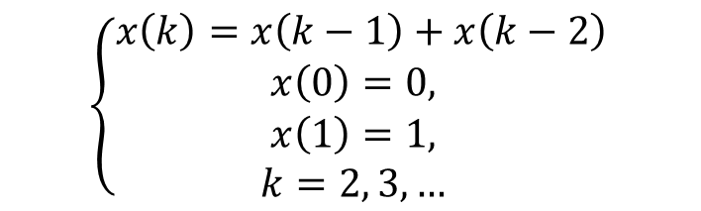
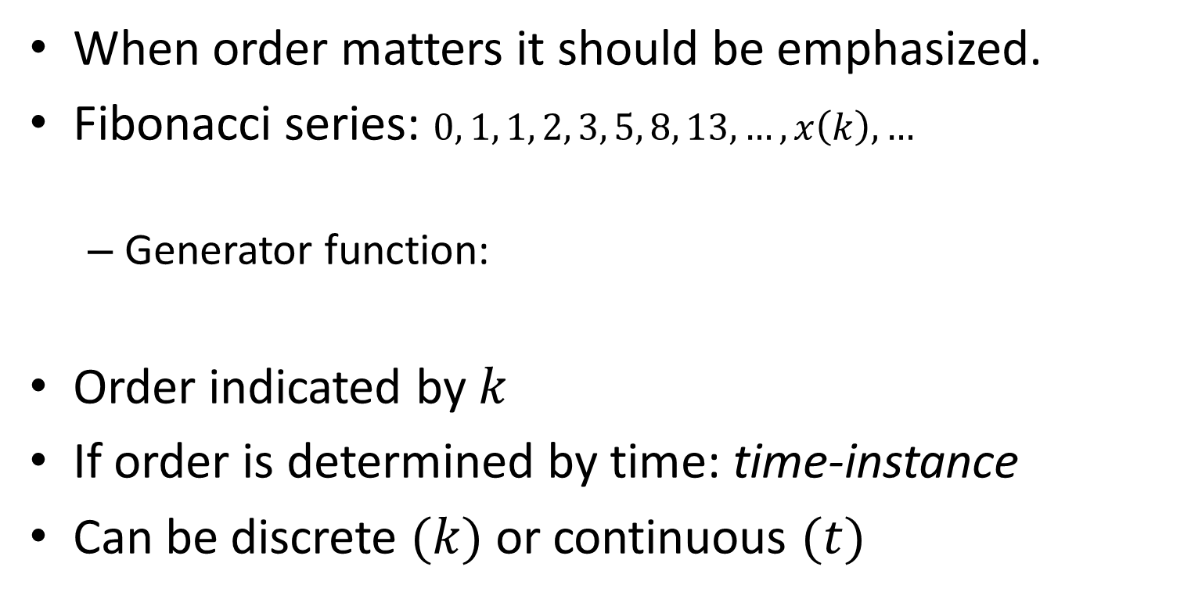
Representation of Signals
When order matters it should be emphasized.
Fibonacci series: $0, 1, 1, 2, 3, 5, 8, 13, …, x\left(k\right),…$
  Generator function:
Order indicated by $k$
If order is determined by time: time-instance
Can be discrete $(k)$ or continuous $(t)$
  $$\left\{\begin{aligned}x\left(k\right)=x\left(k−1\right)+x\left(k−2\right) \\ x\left(0\right)=0, \\ x\left(1\right)=1, \\ k=2, 3, … \end{aligned}\right.$$

Slide 6
What are we looking for?
A dynamic mapping that describes some observations.
The observations are from a dynamic system.
We want to learn the function that led to the observations. (classification or regression (= system identification))
Examples:
  Sequence of words Context (classification)
  Sequence of images Object (classification)
  Voltage signal Motor speed (system identification)
  History of sun spots When the next one occurs (prediction)

Slide 7
What are we looking for?
There are many related fields:
  Systems theory (Linear and Nonlinear)
  Chaos theory (Attractors, Fractals, …)
  System Identification and Modeling (Auto Regressive methods, Volterra series, Wiener series, …)
  Natural Language Processing (NLP)
  …
Our notations will be based on Systems theory

Slide 8







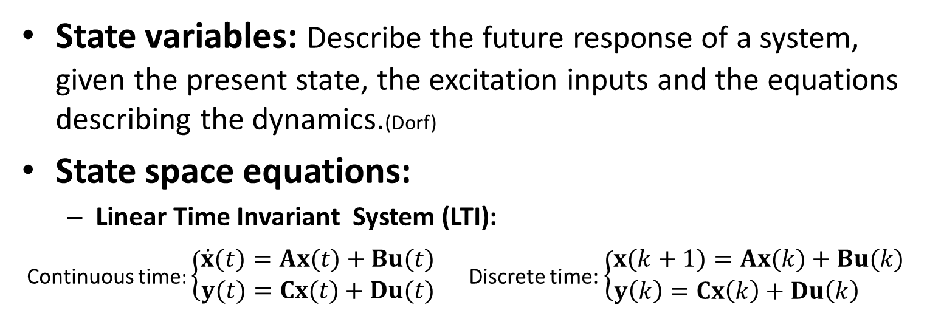











Quick Reminder of Systems Theory (Dynamic)
State variables: Describe the future response of a system, given the present state, the excitation inputs and the equations describing the dynamics.(Dorf)
State space equations:
  Linear Time Invariant System (LTI):
Continuous time: $\left\{\begin{aligned}\dot{x}(t)=Ax(t)+Bu(t) \\ y(t)=Cx(t)+Du(t)\end{aligned}\right.$ Discrete time: $\left\{\begin{aligned}x(k+1)=Ax(k)+Bu(k) \\ y\left(k\right)=Cx\left(k\right)+Du\left(k\right) \end{aligned}\right.$
$$D$$
$$D$$
$$u(t)$$
$$\dot{x}(t)$$
$$x(t)$$
$$y(t)$$
$$u(k)$$
$$x(k+1)$$
$$x(k)$$
$$y(k)$$
$$B$$
+
$$C$$
+
$$B$$
+
$$\frac{1}{z}$$
$$C$$
+
$$A$$
$$A$$

Slide 9


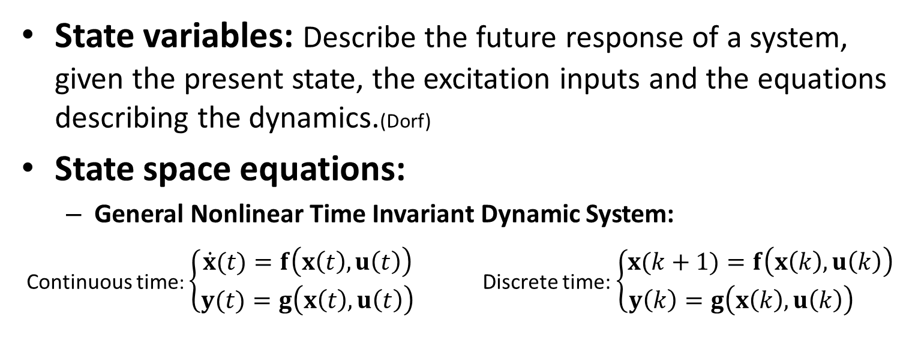












Quick Reminder of Systems Theory (Dynamic)
State variables: Describe the future response of a system, given the present state, the excitation inputs and the equations describing the dynamics.(Dorf)
State space equations:
  General Nonlinear Time Invariant Dynamic System:
Continuous time: $\left\{\begin{aligned}\dot{x}(t)=f\left(x\left(t\right),u\left(t\right)\right) \\ y(t)=g\left(x\left(t\right),u\left(t\right)\right)\end{aligned} \right.$ Discrete time: $\left\{\begin{aligned}x(k+1)=f\left(x\left(k\right),u\left(k\right)\right) \\ y\left(k\right)=g\left(x\left(k\right),u\left(k\right)\right) \end{aligned}\right.$
$$u(t)$$
$$\dot{x}(t)$$
$$x(t)$$
$$y(t)$$
$$u(k)$$
$$x(k+1)$$
$$\frac{1}{z}$$
$$x(k)$$
$$y(k)$$
$$f$$
$$g$$
$$f$$
$$g$$
Check books on Modern Control, such as Modern Control Systems by Dorf and Bishop, For more advanced discussions check Nonlinear Systems by Khalil

Slide 10



Time Delayed Neural Networks
The easiest way to include temporal (sequential) information is to include buffers.
Problems:
  Loses the dynamic nature of the problem.
  How many buffers?
  Can grow exponentially in size w.r.t. number of buffers.
However, we will come back to this later
$$u(k)$$
Can be other forms of FFNNs
$$u(k−1)$$
…
…
$$u(k−τ)$$

Slide 11
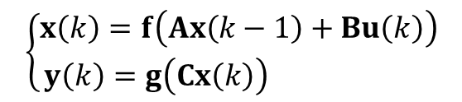







Simple Recurrent Neural Network
A Feedforward NN with feedback connections
A sequence-to-sequence mapper:
  For every (or a bunch of) input instances, the network generates an output
A sequence to non-sequence (class, vector, etc.) mapper:
  The network generates an output once it receives all of the input instances
$$x(k−1)$$
Network states
$$z^{−1}$$
$$\left\{\begin{aligned}x\left(k\right)=f\left(Ax\left(k−1\right)+Bu\left(k\right)\right) \\ y\left(k\right)=g\left(Cx\left(k\right)\right) \end{aligned}\right.$$
Hidden Layer
Output Layer
$$y(k)$$
$$u(k)$$
$$f$$
$$x(k)$$
$$g$$

Slide 12



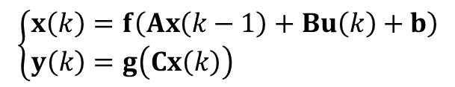








Real Time Recurrent Learning
The gradients are calculated as the network processes the input elements:
$$x(k−1)$$
$$\left\{\begin{aligned}x\left(k\right)=f\left(Ax\left(k−1\right)+Bu\left(k\right)+b\right) \\ y\left(k\right)=g\left(Cx\left(k\right)\right) \end{aligned}\right.$$
$$z^{−1}$$
Hidden Layer
Output Layer
$$y(k)$$
$$u(k)$$
$$f$$
$$x(k)$$
$$g$$
$$u\left(k\right)∈ℝ^{m},$$
$$x\left(k\right)∈ℝ^{s},$$
$y\left(k\right)∈ℝ^{n}$,
$$A∈ℝ^{n}×ℝ^{n},$$
$$B∈ℝ^{n}×ℝ^{m},$$
$$C∈ℝ^{n}×ℝ^{s},$$
$$b∈ℝ^{n},$$
Network input dimension = $m$
Network output dimension = $n$
Hidden layer dimension = $s$
Whiteboard

Slide 13






























Unfolding Back Through Time
RNNs are very deep networks
A sequence to sequence mapper
Example: System identification, time series prediction
$$u(1)$$
$$u(2)$$
$$u(k)$$
$$u(k+1)$$
$$u(T)$$
$$x(0)$$
$$x(1)$$
$$x(2)$$
$$x(k−1)$$
$$x(k)$$
$$x(k+1)$$
$$x(T−1)$$
$$x(T)$$
…
…
$$f$$
$$f$$
$$f$$
$$f$$
$$f$$
$$g$$
$$g$$
$$g$$
$$g$$
$$g$$
$$y(1)$$
$$y(2)$$
$$y(k)$$
$$y(k+1)$$
$$y(T)$$
Weights are SHARED across the network!
A very deep FNN with shared weights
Input sequence
Output sequence
$$U=\left[\begin{matrix}u(1) & … & u(T) \end{matrix}\right]$$
$$Y=\left[\begin{matrix}y(1) & … & y(T) \end{matrix}\right]$$

Slide 14



















Unfolding Back Through Time
A sequence to non-sequence mapper
Examples are text, speech recognition. Usually this mapper is used as a classifier
$$u(1)$$
$$u(2)$$
$$u(k+1)$$
$$u(T)$$
$$x(0)$$
$$x(1)$$
$$x(2)$$
$$x(k)$$
$$x(k+1)$$
$$x(T−1)$$
$$x(T)$$
…
…
$$f$$
$$f$$
$$f$$
$$f$$
$$g$$
$$y$$
Input sequence
A very deep FNN with shared weights
Output
$$U=\left[\begin{matrix}u(1) & … & u(T) \end{matrix}\right]$$
$$y$$

Slide 15
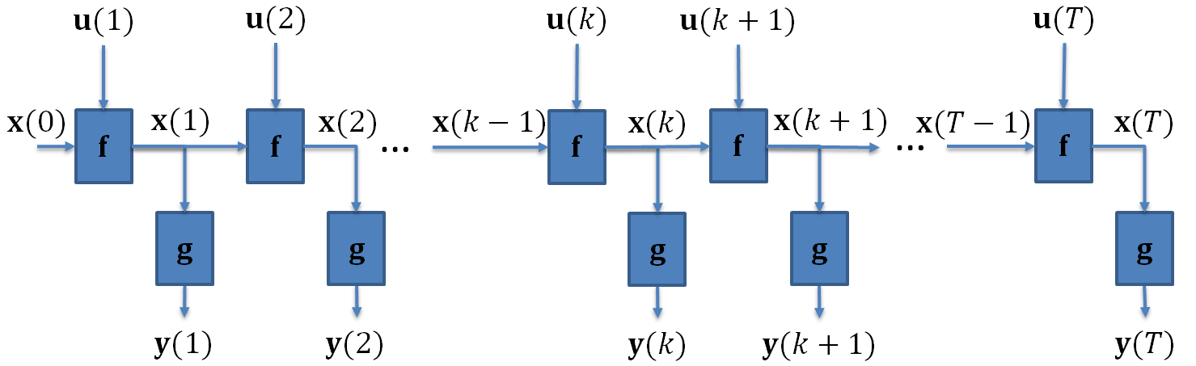
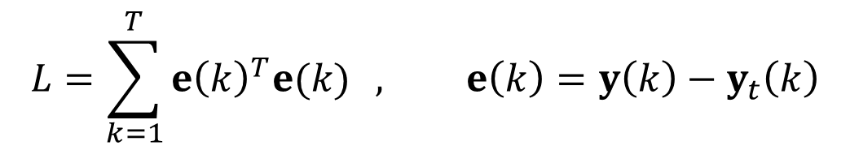
Back Propagation Through Time
Unfold the RNN
back in time:
Form the cost function
  Sequence to sequence mapper (Usually SSE)
  Sequence-to non-sequence mapper: same as before (cross entropy, etc)
$$L=\sum_{k=1}^{T}{{e\left(k\right)}^{T}e(k)} , e\left(k\right)=y\left(k\right)−y_{t}\left(k\right)$$
Targets

Slide 16
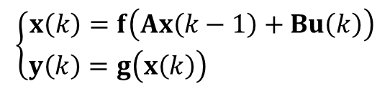
Back Propagation Through Time
Calculate the gradients: use chain rule.
  We need the derivative of the network output w.r.t the network weights:
  The gradients will be recursive. (Do you want to derive the recursive formula?)
$$\left\{\begin{aligned}x\left(k\right)=f\left(Ax\left(k−1\right)+Bu\left(k\right)\right) \\ y\left(k\right)=g\left(x\left(k\right)\right) \end{aligned}\right.$$
Problem: Gradients, as are backpropagated through time, will start to vanish or explode as they are repeatedly multiplied by weights. This is know as the vanishing/exploding gradient problem. It is hard to learn long-term dependencies in RNN!

Slide 17




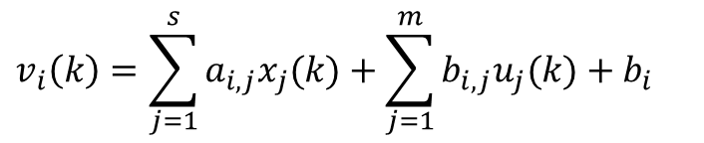





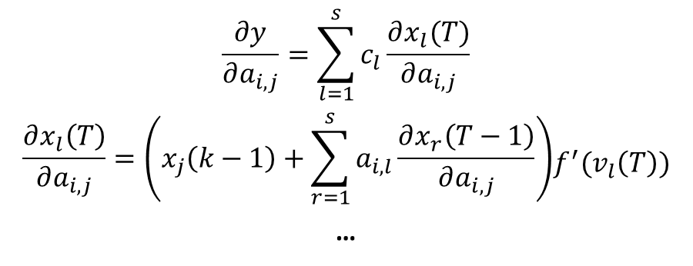





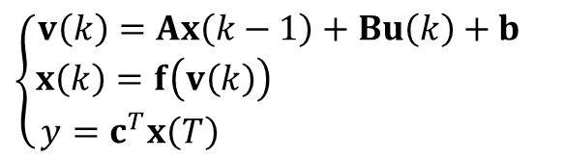



Vanishing/Exploding Gradients
$$u(1)$$
$$u(2)$$
$$u(k+1)$$
$$u(T)$$
$$x(0)$$
$$x(1)$$
$$x(2)$$
$$x(k)$$
$$x(k+1)$$
$$x(T−1)$$
$$x(T)$$
…
…
$$f$$
$$f$$
$$f$$
$$f$$
$$g$$
$$y$$
$$\left\{\begin{aligned}v\left(k\right)=Ax\left(k−1\right)+Bu\left(k\right)+b \\ x\left(k\right)=f\left(v\left(k\right)\right) \\ y=c^{T}x\left(T\right) \end{aligned}\right.$$
$$v_{i}\left(k\right)=\sum_{j=1}^{s}{a_{i,j}x_{j}(k)}+\sum_{j=1}^{m}{b_{i,j}u_{j}(k)}+b_{i}$$
$$\begin{aligned}\frac{∂y}{∂a_{i,j}}=\sum_{l=1}^{s}{c_{l}\frac{∂x_{l}(T)}{∂a_{i,j}}} \\ \end{aligned}$$
$$\begin{aligned}\frac{∂x_{l}\left(T\right)}{∂a_{i,j}}=\left(x_{j}\left(k−1\right)+\sum_{r=1}^{s}{a_{i,l}\frac{∂x_{r}\left(T−1\right)}{∂a_{i,j}}}\right) \\ \end{aligned}f^{′}(v_{l}\left(T\right))$$
…

Slide 18
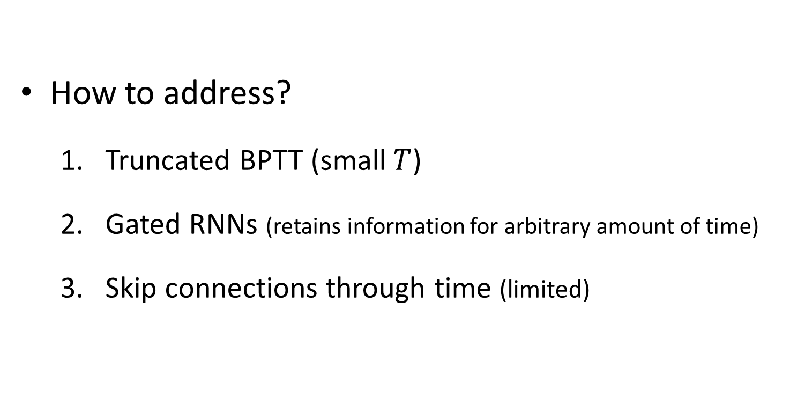
Vanishing/Exploding Gradients
How to address?
  Truncated BPTT (small $T$)
  Gated RNNs (retains information for arbitrary amount of time)
  Skip connections through time (limited)

Slide 19
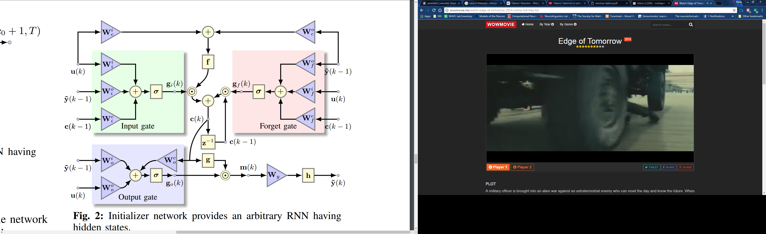

Long-Short-Term-Memory Cell
The most general LSTM cell

Slide 20

Long-Short-Term-Memory Cell
The most general LSTM cell

Slide 21

Long-Short-Term-Memory Cell
The most general LSTM cell

Slide 22
Long-Short-Term-Memory Cell
The most general LSTM cell

Slide 23

Long-Short-Term-Memory Cell
The most general LSTM cell

Slide 24
Long-Short-Term-Memory Cell
The most general LSTM cell

Slide 25
Long-Short-Term-Memory Cell
The most general LSTM cell
Peephole connections

