Slide 1
Efficient Deep Model for Monocular Road Segmentation
Paper by: Gabriel L. Oliveira, Wolfram Burgard, Thomas Brox
(University of Freiburg, Germany)
Presented by: Samin Khan

Slide 2
Intro
convolution layers:
high-res image => low-res output
up-convolution layers (de-convolutions):
low-res, abstract features => high-res image prediction
state-of-the-art semantic segmentation networks have inference times that are >= 150 ms (upwards of a second in some cases; not real-time)
proposed parameter optimization achieves 83 ms inference time on 500x500 images

Slide 3
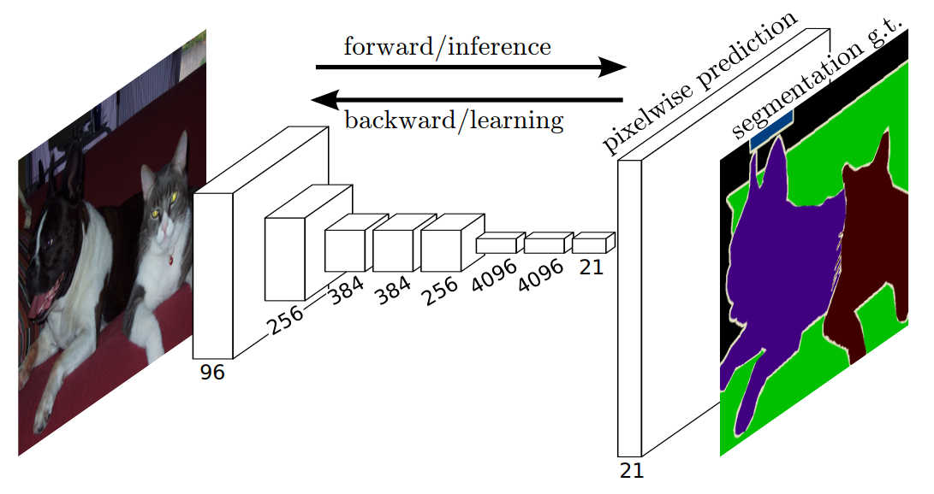
Related Work
Fully Convolutional Network (FCN):
- take feature extractor layers of a classification
network such as VGG
- attach up-convolution layers that create coarse score maps for pixel-level classification
- successive up-convolution “refinements” increase resolution of these score maps

Slide 4
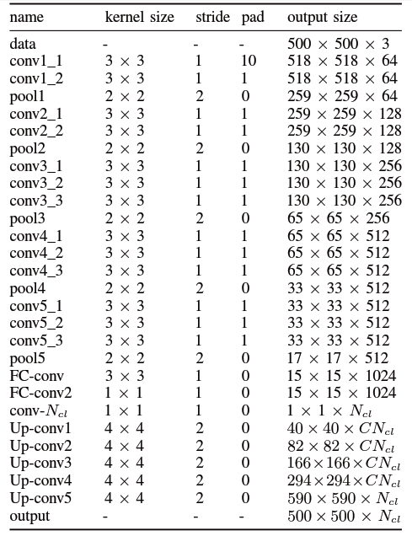
Methodology: Architecture

Slide 5
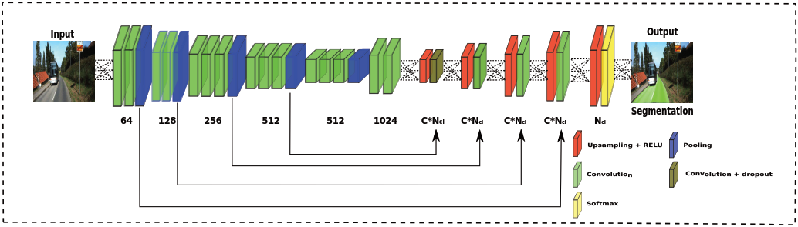
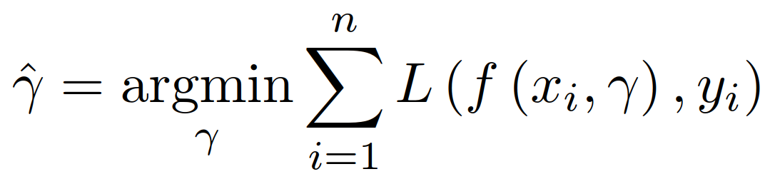
Methodology: Architecture

Slide 6
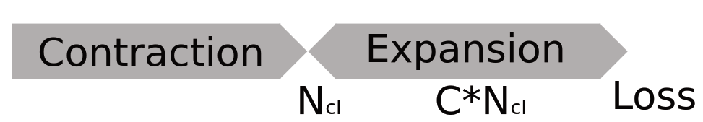
Methodology: Parameter Optimization
parameter reduction:
- base FC-conv layers have 4096 filters of 7x7 size
- this paper proposes 1024 filters of 3x3 size
new parameters in the up-conv layers:
- substantial reduction in FC-conv layers means parameters needed elsewhere to preserve accuracy
- an empirical scalar C is introduced in all intermediate up-conv layers

Slide 7
Methodology: Data Augmentation
scaling:
- training images scaled by a factor between 0.7 and 1.4
color:
- value between -0.1 and 0.1 added to the hue channel of the input images’ HSV representation
rotation and cropping:
- NOT used because these potentially reduce network’s learning of spatial priors

Slide 8
Methodology: Hyper-parameters
weights initialization: Xavier (mean = 0; variance = 1/n_{in})
momentum: 0.95 (effect of previous state of weights)
C: 5 (empirical parameter; problem dependent)
N_{cl}: 3 (output classes: road, fake road, non-road)
learning rate: 1e-9 (size of jump towards gradient descent)
learning rate decay policy: poly (reduction in jump size as learning progresses)
power: 0.9 (decay factor of learning rate)

Slide 9
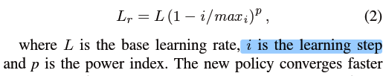
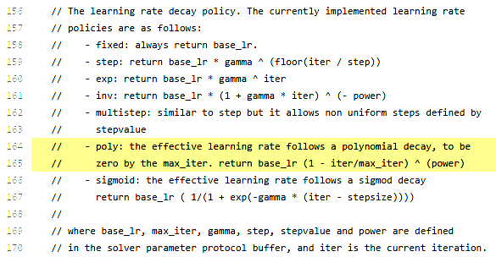
Methodology: Hyper-parameters
https://github.com/BVLC/caffe/blob/master/src/caffe/proto/caffe.proto

Slide 10
Methodology: Architecture

Slide 11
Methodology: Architecture

Slide 12
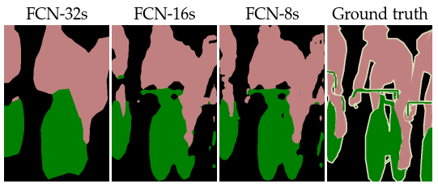
Methodology: Training
Refinement 1:
conv layers
fc-CONV1 + relu
dropout
fc-CONV2 + relu
dropout
SCORE
DECONV_big_score
crop
SOFTMAX loss

Slide 13
Methodology: Training
Refinement 2:
conv layers
DEconv_score
conv_score_pool4
fc-CONV1 + relu
crop
dropout
sum
fc-CONV2 + relu
dropout
SCORE
DECONV_big_score
crop
SOFTMAX loss

Slide 14
Methodology: Training
Refinement 3:
conv layers
DEconv_score
conv_score_pool4
fc-CONV1 + relu
crop
dropout
sum
fc-CONV2 + relu
DEconv_score
conv_score_pool3
dropout
crop
SCORE
sum
DECONV_big_score
crop
SOFTMAX loss

Slide 15
Methodology: Training
Refinement 4:
conv layers
DEconv_score
conv_score_pool4
fc-CONV1 + relu
crop
dropout
sum
fc-CONV2 + relu
DEconv_score
conv_score_pool3
dropout
crop
SCORE
sum
DECONV_big_score
DEconv_score
conv_score_pool2
crop
crop
sum
SOFTMAX loss

Slide 16
Methodology: Training
Refinement 5:
DEconv_score
conv_score_pool4
crop
conv layers
sum
fc-CONV1 + relu
DEconv_score
conv_score_pool3
dropout
crop
fc-CONV2 + relu
sum
dropout
DEconv_score
conv_score_pool2
SCORE
crop
DECONV_big_score
sum
crop
DEconv_score
conv_score_pool1
SOFTMAX loss
crop
sum

Slide 17
Methodology: Training
Refinement 6:
DEconv_score + ReLU
conv_score_pool4
DROPOUT
conv layers
sum
crop
fc-CONV1 + relu
DEconv_score + ReLU
conv_score_pool3
dropout
crop
fc-CONV2 + relu
sum
dropout
DEconv_score + ReLU
conv_score_pool2
SCORE
crop
DECONV_big_score
sum
crop
DEconv_score + ReLU
conv_score_pool1
SOFTMAX loss
crop
sum

Slide 18
Methodology: Training
Refinement 7:
DEconv_score + ReLU
conv_score_pool4
DROPOUT
conv layers
sum
crop
fc-CONV1 + relu
DEconv_score + ReLU
conv_score_pool3
dropout
crop
fc-CONV2 + relu
sum
dropout
DEconv_score + ReLU
conv_score_pool2
SCORE
crop
FINAL_score
sum
DECONV_big_score
DEconv_score + ReLU
conv_score_pool1
crop
crop
sum
SOFTMAX loss

Slide 19
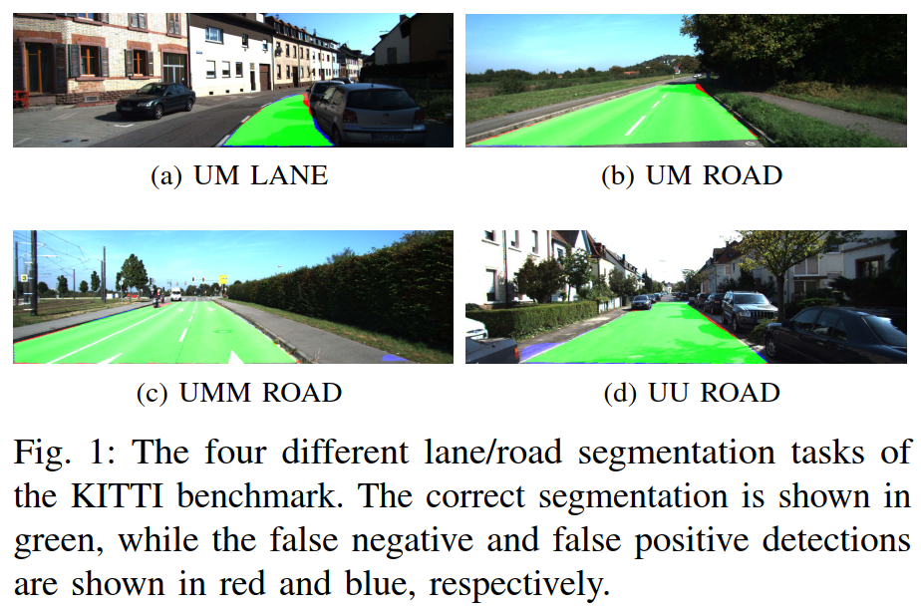
Experiment: KITTI Road/Lane Dataset
Training:
95
Testing:
96
Training:
96
Testing:
94
Training:
98
Testing:
100

Slide 20
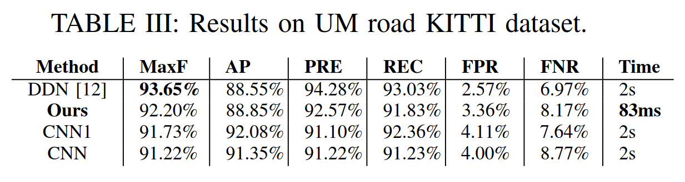
Experiment: KITTI Road/Lane Dataset
Training:
95
Testing:
96
Training:
96
Testing:
94
Training:
98
Testing:
100

Slide 21
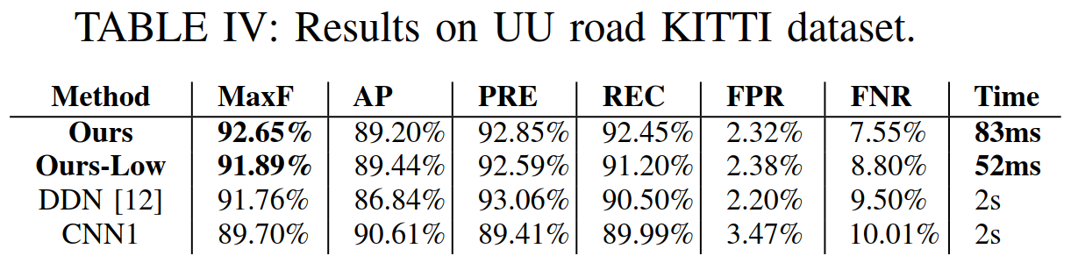
Experiment: KITTI Road/Lane Dataset
Training:
95
Testing:
96
Training:
96
Testing:
94
Training:
98
Testing:
100

Slide 22
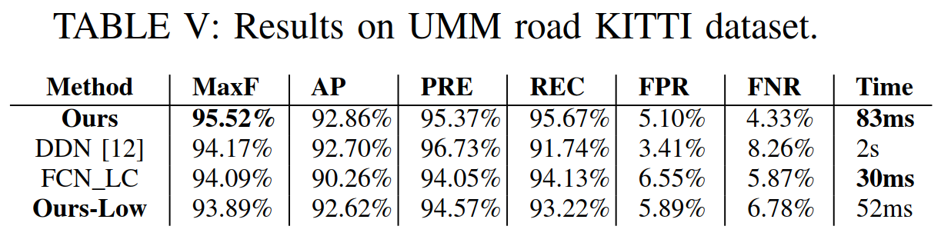
Experiment: KITTI Road/Lane Dataset
Training:
95
Testing:
96
Training:
96
Testing:
94
Training:
98
Testing:
100

Slide 23
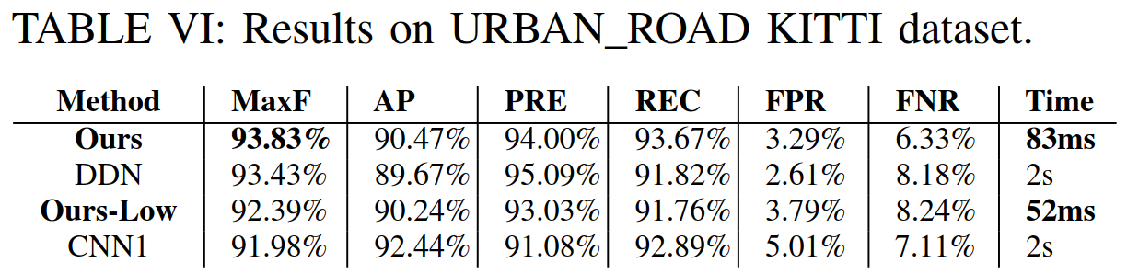
Experiment: KITTI Road/Lane Dataset
Training:
95
Testing:
96
Training:
96
Testing:
94
Training:
98
Testing:
100

Slide 24
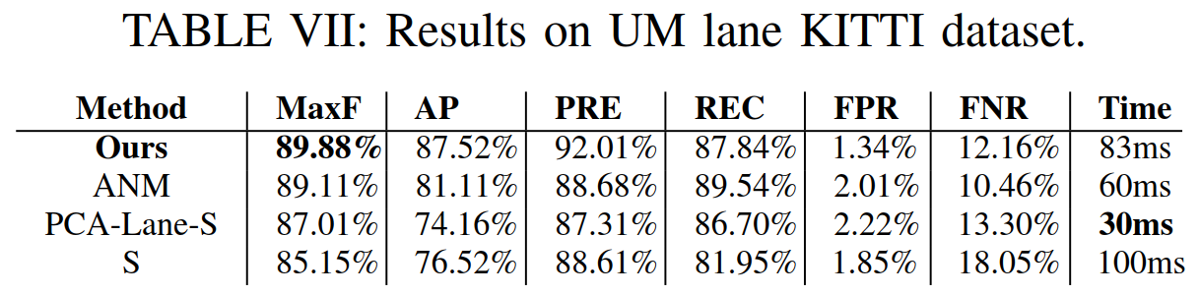
Experiment: KITTI Road/Lane Dataset

Slide 25
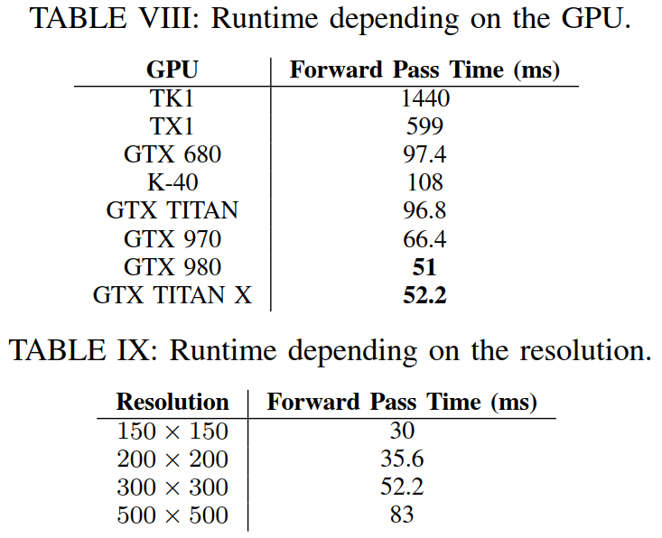
Experiment: Performance
(300x300 image)
(Titan X GPU)

Slide 26
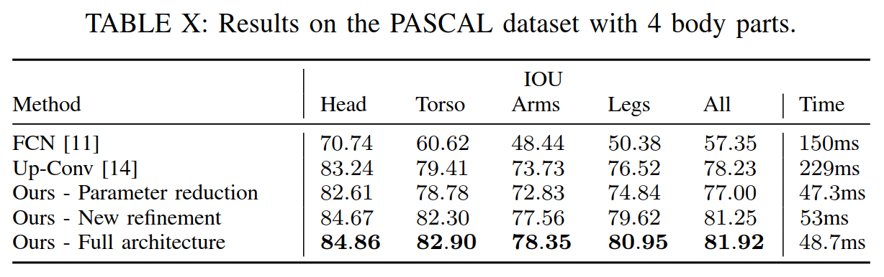
Experiment: Impact of Parameter Reduction and New Refinement
- performed on PASCAL Parts dataset
(due to restriction on number of submissions to KITTI)

Slide 27
Conclusion
changing filter size of fully convolutional layers dramatically improves performance, as long as new parameters are introduced elsewhere (scalar “C” increased filter space of intermediate up-convolutional layers) to preserve network accuracy
training up-convolutional networks can be painful

