Slide 1
Deep MANTA
A Coarse-to-fine Many-Task Network for joint 2D and 3D vehicle analysis from monocular image
Presented By: Adam Sanderson
June 14th 2017
Notes:
STUFF TO DO:
Fix overview
Proofread and review!!

Slide 2
Overview
Purpose
Network Architecture
Data Types
RPN
Augmenting Training Data
Training and Losses
2D to 3D Part Matching
Performance
Contributions
Conclusions

Slide 3
Purpose
Used for getting 2D bounding boxes and 3D orientation, bounding box and point features of cars
Only deals with finding cars. No pedestrian cyclists or other objects

Slide 4
Network Architecture
“Conv layers with the same color share the same weights. Moreover, these three convolutional blocks correspond to the split of existing CNN architecture”
Notes:
There is mention of offset transformations being down on object proposals from the first and second level before being sent to the next level. This is however not explained or brought up aside from a single sentence. The code is also not available to verify this.
Light Blue – Shareable Layers 13 for VGG16
Blue – Shared Layers – Unsure of purpose, possibly small convolutional network from RPN but RPN is the green box so can’t be sure if those are shared.
Orange – Other Layers of Network (VGG16, GoogLeNet)

Slide 5
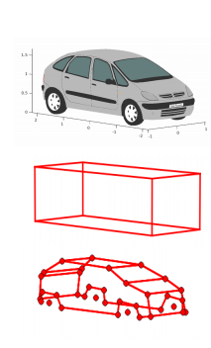
Data Types
Car Template
${\overline{S}}_{m}^{3d}=\left(p_{1},p_{2}…p_{n}\right)$ where $p_{k}=(x_{k}$, $y_{k}$, $z_{k}$)
${\overline{t}}_{m}^{3d}=\left(w_{m},h_{m},l_{m}\right)$
Object Proposal
$B_{i,l}=\left(c_{x},c_{y},w,h\right)$ where i is the index of the object proposal, l is the level of the network, $c_{x}$ and $c_{y}$ are the center points of the bounding box, and w and h are the width and height respectively

Slide 6
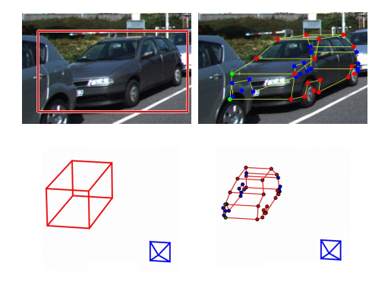
Data Types Continued
Level 3 output
$B_{i,l}$ - 2d bounding box
$S_{i}= \left(p_{1},p_{2}…p_{n}\right)$ where $p_{k}=(u_{k}$,$v_{k}$)
2d point output
$V_{i}$ - Visibility of points with 4 potential states
Visible
Occluded by other object
Self Occluded
Truncated
$T_{i}=\left\{r_{m}\right\}, r_{m}=\left(r_{x},r_{y},r_{z}\right)$
Template Similarity (Scaling Factors to fit to templates)
After Template Matching
$S_{j}^{3d}=\left(p_{1},p_{2}…p_{n}\right)$ where $p_{k}=(x_{k}$, $y_{k}$, $z_{k}$)
This is the 3d coordinates of the points in the model
$B_{j}^{3d}=\left(c_{x},c_{y},c_{z},θ,t\right)$ where $c_{x}$, $c_{y}$, and $c_{z}$ are the center points of the 3d bounding box, $θ$ is the orientation and t is its 3d template
$t=(w,l,h)$

Slide 7
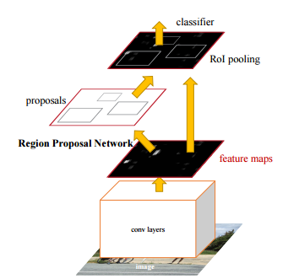
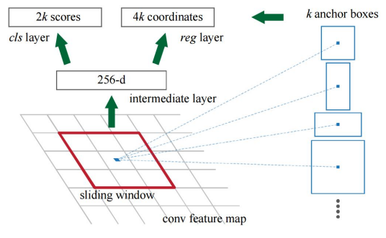
Region Proposal Network
Inputs any size Image outputs set of rectangles with objectiveness scores
Slides window with center anchor across feature map
Sliding windows are small convolutional networks
At each anchor position k proposals are created
Default k = 9 (3 scales, 3 aspect ratios)
Proposals sent 2 two fully connected layers
Bounding box regression layer
Box classification layer
Shares layers with classifiers
ZF shares 5
VGG-16 shares 13
Total Outputs
Total Anchor number n = WHk where W and H are the width and height of the image
Object Probability 2n outputs
Box coordinates 4n outputs
Total 6WHk outputs

Slide 8
Augmenting Training Data
The KITTI data set does not have the points described in the network so it must be modified in order for this network to be properly trained.
Steps
Compare model bounding box to 3d bounding box in data set
Match model to 3d model – Orient properly
Project 3d points from model into 2d bounding box in data set
Assign occlusion values to points by looking at oriented model

Slide 9
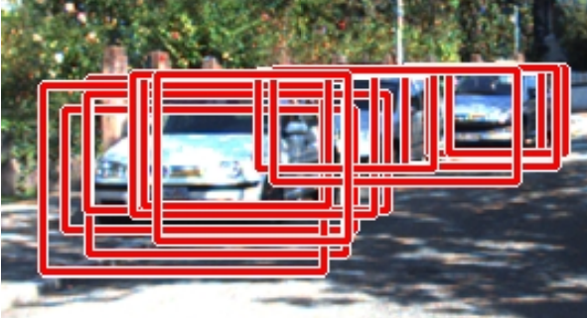
Training
“We use the FasterRCNN framework based on RPN to learn the end-to end
MANTA model” – My assumption is that they use the same alternating training and “Image-Centric” stochastic gradient descent method as Faster RCNN
4 step alternating training (Faster RCNN)
Train RPN
Train Detector network (Fast RCNN)
Combine network and train RPN specific layers
Conv layers come from Detector
Fix shared and Detector specific layers
Train Detector fully connected layers
All other layers fixed
Other Methods also in the paper
Approximate Joint Training
Non-approximate Joint Training
“Image-Centric” Training
Training is also done via stochastic gradient descent using mini-batches of proposals from a single image RPN calculates anchors
256 anchors randomly chosen
1:1 ratio of positives and negatives
If less than 128 positives exist anchors exist false positives are added

Slide 10
Loss Functions - General
Global
$$ℒ= ℒ^{1}+ℒ^{2}+ℒ^{3}$$
Layer 1
$$ℒ^{1}=ℒ_{rpn}$$
Layer 2
$$ℒ^{2}=\sum_{i}{ℒ_{det}^{2}\left(i\right)+ℒ_{parts}^{2}\left(i\right)}$$
Layer 3
$$ℒ^{3}=\sum_{i}{ℒ_{det}^{3}\left(i\right)+ℒ_{parts}^{3}\left(i\right)+ℒ_{vis}\left(i\right)+ℒ_{temp}(i)}$$
Where i is the index of the proposed region
Notes:
I believe that the Parts loss in layer two may not exist. There is no mention of a parts output being extracted at the second layer within the paper. It also seems like a waste of computational power to calculate an output that will not be used. Though it is possible that this is used during training and the layers are disabled at run time. However again this is not mentioned.

Slide 11
Loss Functions – Specifics - RPN
RPN Loss – From Faster RCNN
$$ℒ_{rpn}\left(\left\{p_{i}\right\},\left\{t_{i}\right\}\right)= \frac{1}{N_{cls}}\sum_{i}{ℒ_{cls}(p_{i}, p_{i}^{∗}) }+λ\frac{1}{N_{reg}}\sum_{i}{p_{i}^{∗}ℒ_{reg}(t_{i}, t_{i}^{∗})}$$
$p_{i}$ and $p_{i}^{∗}$ are the prediction and the ground truth of wether the box $i$ is a positive detection.
$$ℒ_{reg}\left(t_{i}, t_{i}^{∗}\right)=R(t_{i}−t_{i}^{∗})$$
$ℒ_{cls}\left(p_{i}, p_{i}^{∗}\right)$ is the log loss over 2 classes or $P\left(p_{i}, p_{i}^{∗}\right)$
Value of $p_{i}$?
$p_{i}$ is positive when…
Highest intersection-over-Union(IoU) overlap with the ground truth
IoU overlap higher than 0.7 with any ground truth
$p_{i}$ is negative when…
IoU is less than 0.3 for all ground truths.
Robust Smooth L1 Loss
$$R\left(x\right)= \left\{\begin{aligned}0.5x^{2} \\ \left|x\right|−0.5\end{aligned}\right. \begin{matrix}if \left|x\right|<1 \\ otherwise,\end{matrix}$$
$P\left(y_{i},z\right)$ is the standard log softmax/cross-entropy loss
$$P\left(y_{i},z\right)= z_{i}−log\sum_{j}{e^{z_{j}}}$$
x, y, w and h are the bounding boxes center coordinates, width and height respectively.
x, x_{a} and x* are for the predicted, anchor and ground truth boxes respectively.
Notes:
When Pi is not positive or negative then it will not be chosen for training

Slide 12
Loss Functions – Specifics – Deep Manta
$C_{i,l}^{∗}$ and $C_{i,l}$ are the predicted and true class labels for a proposal. (This is the opposite of the RPN loss where * denotes the true label). This is either 1 or 0 for an object or not an object respectively.
Detection Loss
$$ℒ_{det}^{l}\left(i\right)=λ_{cls}P\left(C_{i,l}^{∗},C_{i,l}\right)+λ_{reg}C_{i,l}R\left(Δ_{i,l}^{∗}−Δ_{i,l}\right)$$
$$Δ_{i,l}=\left(δ_{x},δ_{y},δ_{w},δ_{h}\right)$$
Part Loss
$$ℒ_{parts}^{l}\left(i\right)=λ_{parts}C_{i,l}R\left(S_{i,l}^{∗}−S_{i,l}\right)$$
$S_{i,l}=\left({\overline{q}}_{1},{\overline{q}}_{2},…{\overline{q}}_{N}\right)$
$${\overline{q}}_{k}=\left(\frac{u_{k}−c_{x_{i,l}}}{w_{i,l}},\frac{v_{k}−c_{y_{i,l}}}{h_{i,l}}\right)$$
$S_{i,l}$ is the scaled part output of level l and proposal i
Visibility Loss
$ℒ_{vis}\left(i\right)=λ_{vis}C_{i,3}P\left(V_{i}^{∗}−V_{i}\right)$
Template Similarity Loss
$$ℒ_{temp}\left(i\right)=λ_{temp}C_{i,3}R\left(T_{i}^{∗}−T_{i}\right)$$
Parameters
In their tests they set all $λ$ values to 1 except for $λ_{parts}$ which was set to 3.
Where the predicted bounding box is…
$$B_{i,l}=\left(c_{x_{i,l}},c_{y_{i,l}},w_{i,l},h_{i,l}\right)$$
and $c_{x}$, $c_{y}$, w, and h are from the ground truth bounding box

Slide 13
2D to 3D Matching
Using Template similarity output from the network the proper CAD data is selected (CAD data associated to template similarity value closest to (1,1,1). The points from the chosen model are then scaled using the template similarity output.
The 2D and scaled CAD data are then match using the algorithm from the following paper
V. Lepetit, F.Moreno-Noguer, and P.Fua. Epnp: An accurate o(n) solution to the pnp problem. IJCV, 2009.

Slide 14
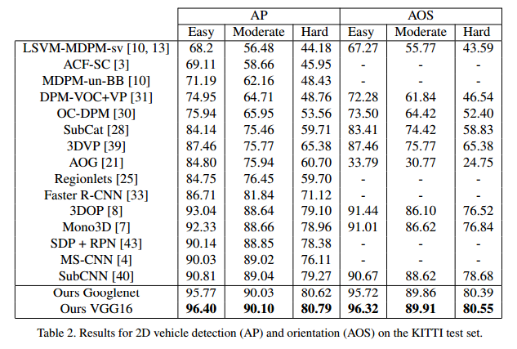
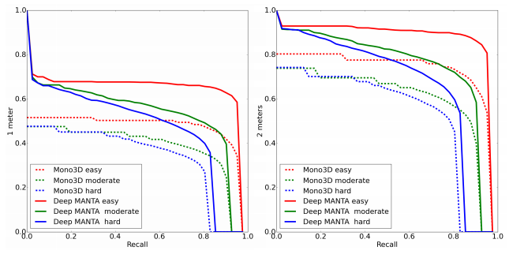
Performance - Paper
Recall/3D localization precision curves at 1 and 2 meters

Slide 15
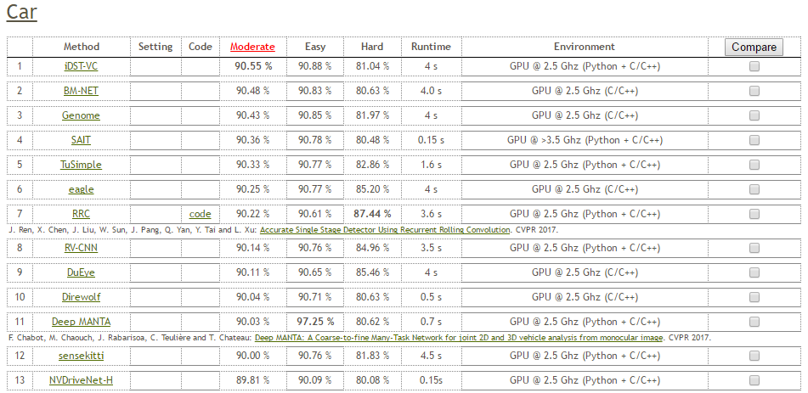
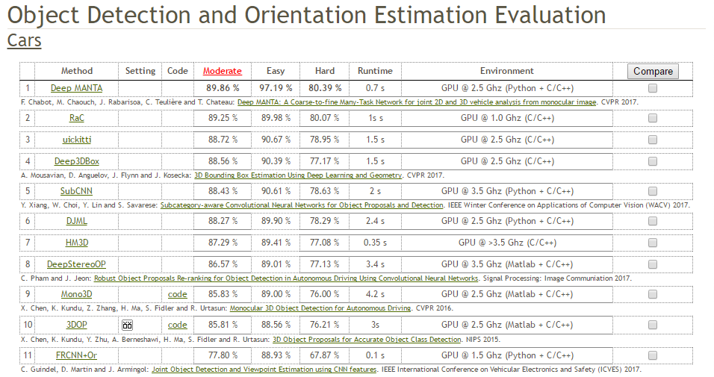
Performance – KITTI Ranking
11th place in Object Detection Evaluation- Cars
1st place in Object Detection and Orientation Estimation Evaluation - Cars
Screenshots taken on June 7th 2017

Slide 16
Contributions
Using CAD Data to modify training set and find 3D orientation
Point Estimation
Doesn’t just find bounding boxes
Quick Accurate Results in KITTI dataset

Slide 17
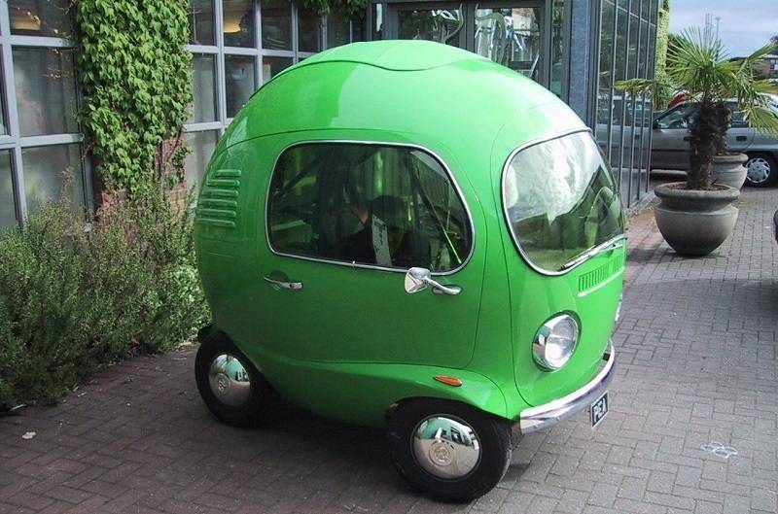
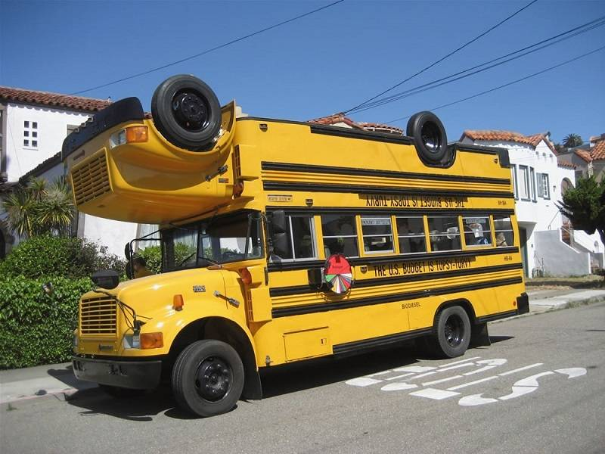
Conclusion
Interesting approach to detection
Could easily add support for other types of objects
Pedestrian, Cyclist
Point/CAD data inclusion is interesting approach but relies on cars being somewhat consistently shaped for 3D matching
Odd vehicles may lead to odd results

Slide 18
References
Deep MANTA: A Coarse-to-fine Many-Task Network for joint 2D and 3D vehicle analysis from monocular image
S. Ren, K. He, R. Girshick and J. Sun, "Faster R-CNN: Towards Real-Time Object Detection with Region Proposal Networks", IEEE Transactions on Pattern Analysis and Machine Intelligence, vol. 39, no. 6, pp. 1137-1149, 2017.
V. Lepetit, F. Moreno-Noguer and P. Fua, "EPnP: An Accurate O(n) Solution to the PnP Problem", International Journal of Computer Vision, vol. 81, no. 2, pp. 155-166, 2008.

