Slide 1
Batch Estimation, Solving Sparse Linear Systems in Information and Square-Root Form
June 12, 2017
Benjamin Skikos

Slide 2
Outline
Information & Square Root Filters
Square Root SAM
Batch Approach
Variable ordering and structure of SLAM
Incremental Approach 1
Bayes Tree
Incremental Approach 2

Slide 3
Information Form
Notes:
http://robots.stanford.edu/papers/thrun.seif.pdf
This is the map for an example of landmark SLAM. Displayed to the right of it are the covariance and information matrices. As part of the classic EKF SLAM, the covariance gets inverted. Clearly it is dense, so that operation is expensive.
To the right of that is the information matrix (inverse of the covariance). So sparse.

Slide 4
Extended Information Filter
EKF represents posterior as mean and covariance
EIF represents posterior as information matrix and information vector
Notes:
Xi is the state vector at time t
Z is the set of measurements at time t
U is the set of measurements at time t
Mu is the mean of the state at time t
Sigma is the covariance at time t
To arrive at this form, multiply out stuff in exponent, absorb the constant into the proportionality sign, and then define H and b

Slide 5
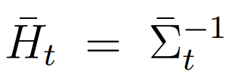
Information Filter Motion Update
From the EKF
Notes:
U is covariance on process model
S is a projection matrix to enlarge U to the full state size (Identities and zeros)
Delta is the change in state
A is Jacobian of the motion model A = d(g(ut-1,ut)/d(Xi)
For a dense information matrix, this update is slow, but if H is sparse, there exists almost constant time updates (constant in number of landmarks)

Slide 6
Information Filter Measurement Updates
Notes:
This is using Bayes’ rule.
Non-zero elements in the information matrix correspond to local dependencies between the variables. Only those variables directly involved in the measurement are effected by a measurement.
C is the transpose of the Jacobian of the measurement. Notice that if the measurement is binary, CZC with only have four non-zero entries.
Z is the measurement
U is the mean of the state
Xi is the state
Z is the measurement covariance

Slide 7
Square Root Filter
Historically motivated by limited computer precision
Factorize either covariance or information and rederive propagation and update equations
Condition number is halved
$H=SS^{T}$
Notes:
Not only is the condition number halved, which is important for stable inversion, but this representation of H also retains positive definiteness.
Measurement and update equations are a bit more involved, and are omitted here because it isn’t really important to talk about Square Root SLAM.

Slide 8
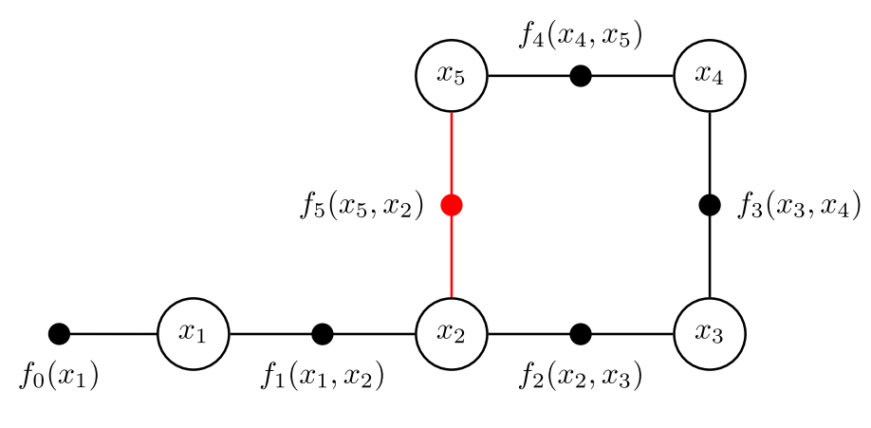
Smoothing
In this context smoothing will be the “full SLAM problem”; estimate the robot’s trajectory and surroundings given all available measurements.
For factor graphs, that means optimize over all the unknown states
Recall, factors encode the joint probability over all unknowns
Notes:
Note on smoothing vs filtering. In filtering, the entire trajectory is not kept, rather, old states are periodically marginalized out. That results in the information matrix eventually becoming fully dense.
Smoothing also may not refer to keeping the entire trajectory. Fixed-lag ecetera.

Slide 9
Factor Graph Optimization
Recall, to solve a factor graph it is converted to LLS. From here on out it is all about crunching matrices
A is the stack of all factor Jacobians (Measurement Jacobian)
B is the stack of all measurement/process model error
Notes:
More on the error. More precisely it is the error between the known measurement and the measurement model given the previous iteration’s state.
As far as the measurement Jacobian, each row is a different factor, and so the non-zero entries display how each factor depends on the different unknown.
Delta could be the change in state if this is nonlinear and iterated, or could just be the state in the linear case.

Slide 10
Information Form - SAM
The solution is found by solving the normal equations
A^{T}A is the information matrix or Hessian
Efficiently solved by factorization
Batch problem now solved
Notes:
According to Wikipedia, the general complexity of for matrix inversion is O(n^2.373) to O(n^3).

Slide 11
Ex: Cholesky Factorization
In this variant, R is an upper triangular matrix
The sparseness of R and I affects how long the factorization takes
Worst case fully dense: n³/3
The sparseness of R changes with variable ordering in the information matrix
Notes:
Side note, notice that R is a square root of I. This is where the square root form is coming from.
Notice that the condition number of R is half that of I

Slide 12
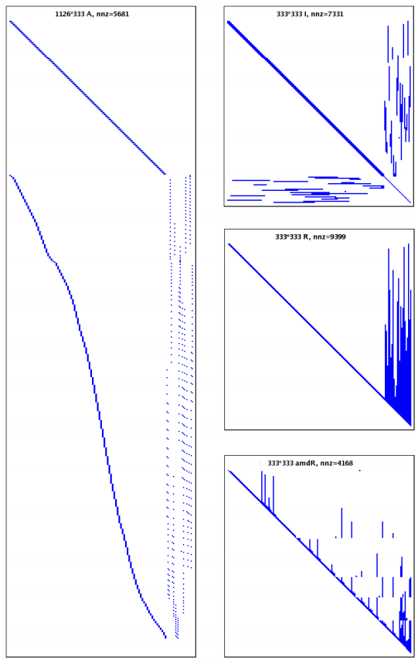
Matrix Structure
A corresponds to the factor graph
I corresponds to the adjacency matrix of the Markov Random Field.
Each square root factor is associated with a triangulated (or chordal) graph whose elimination corresponds with the Bayes Net
Notes:
Picture taken from SAM SLAM. Variables are poses followed by landmarks
Some graph definitions:
Triangulated graph: A graph that is planar such that the addition of any edge results in non-planar graph
Planar graph: A graph that can be drawn in one plane such that no edges cross
Chordal graph: All cycles of four or more vertices have a chord, which is an edge not part of the cycle but connects two vertices of the cycle
Clique: A subset of vertices in an undirected graph such that its induced subgraph is complete; every two distinct vertices in the clique are adjacent.

Slide 13
Markov Random Field
Undirected graph with Markov properties:
Pairwise: Any two non-adjacent variables are conditionally independent given all other variables
Local Markov: A variable is conditionally independent of all other variables given its neighbors
Global Markov: Any two subsets of variables are conditionally independent given a separating subset
https://en.wikipedia.org/wiki/Markov_random_field
Notes:
https://en.wikipedia.org/wiki/Markov_random_field

Slide 14
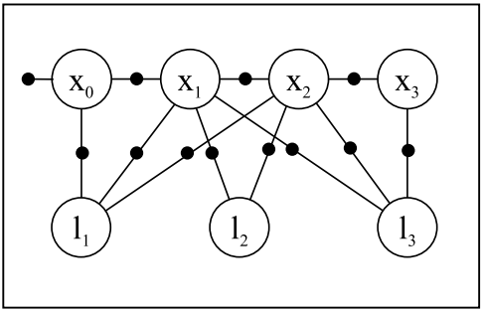
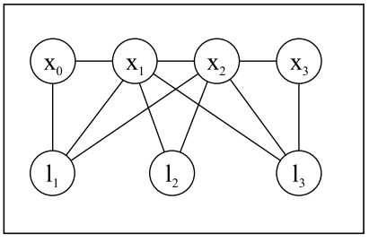
Factor Graph to Markov Random Field
Factors are abstracted out
MRF edges represent dependencies between random variables
Like factor graphs, encode joint probability
Notes:
Markov random fields are undirected graph models. In general, there may not be an equivalent factor graph for an MRF, however for SLAM problems the factor graph always exists.

Slide 15
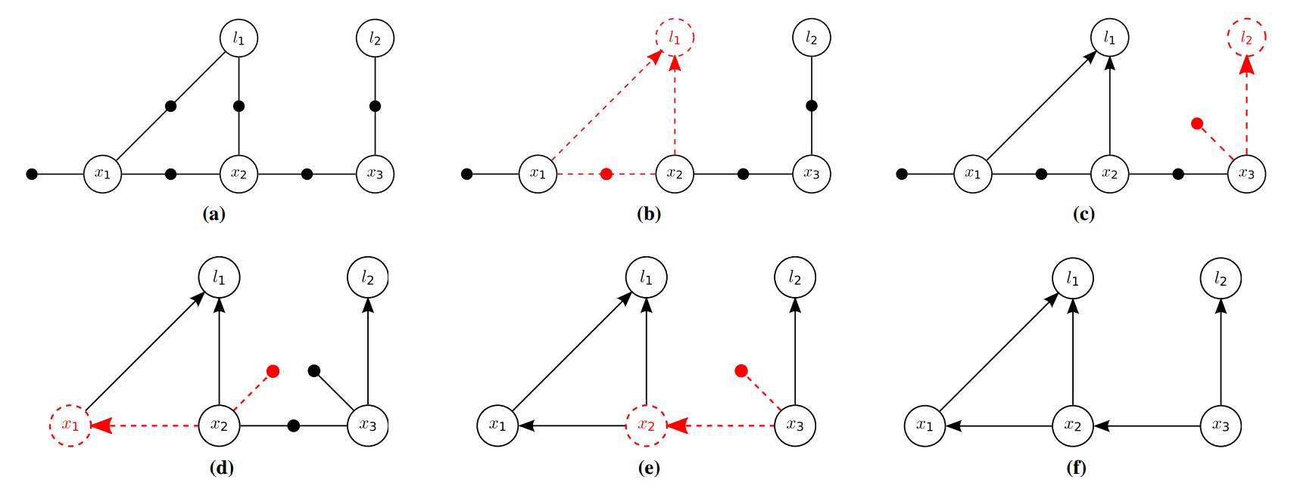
Factor Graph To a Bayes Net
Notes:
A Bayes net is a DAG model. It encodes the joint probability as conditional probabilities between all of the random variables.

Slide 16
MRF to Bayes Net
Additional Conditionals
Notes:
A Bayes net is a DAG model. It encodes the joint probability as conditional probabilities between all of the random variables.
Joint Probability can be evaluated a bit more directly. For an MRF, have to evaluate joint probability of each clique.
Cool thing about these resulting nets. They are cordal.
Fundamentally, we are solving a linear system. Solving a linear system is done by eliminating variables by expressing them as linear combinations as the other variables.

Slide 17
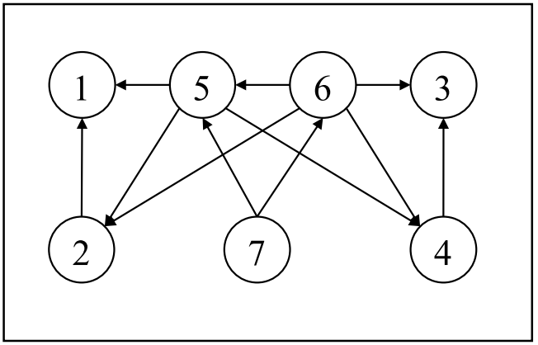
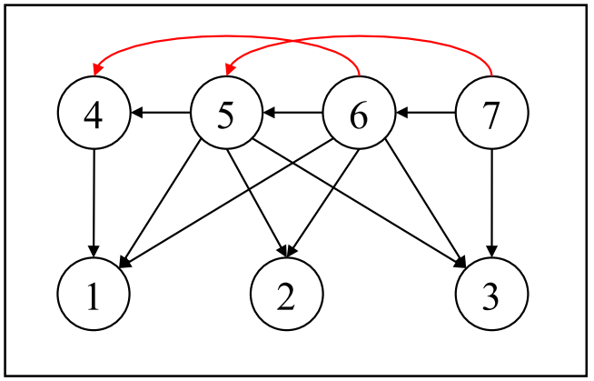
Variable Ordering
MRF
ColAMD Elimination Ordering
Landmarks, Then Poses
Finding the optimal ordering is NP-Complete
Fewer edges means faster back-substitution
Notes:
Finding the optimal elimination order is NP-Complete!
Some heuristics for variable ordering:
General column approximate minimum degree
Landmarks, poses
Constrained ColAMD.
Different environments may have different optimal orderings. You can try to use domain-knowledge to improve ordering: Most recent poses are probably going have new measurements, so keep them at the end of the matrix. You might try grouping loops together.
Homework: Draw the structure of the factorized matrix/matrices for the variable orderings using a factorization method of your choosing.

Slide 18
Online SAM
Most new measurements only directly affect a small subset of the state vector
Need a way to add state elements incrementally without redoing work
Notes:
This is beyond batch, but come on.

Slide 19
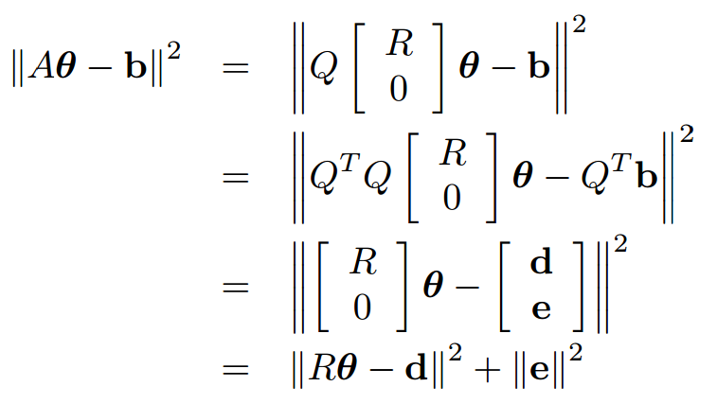
Incremental Approach - ISAM
Consider the QR factorization of A substituted for A
Notes:
Q is orthogonal. This is why throwing that Qt in doesn’t change anything
Q is built up by applying a number of linear transformations to A with goal of removing all non-zero elements below the diagonal.

Slide 20
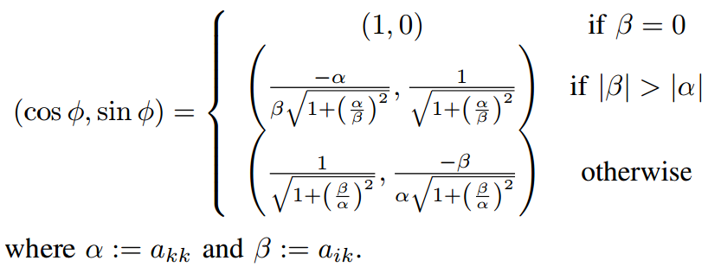
Givens Rotations
Notes:
This expression for cos and sin is done so that it never overflows.
Givens rotations can be used to perform QR decomposition. Householder reflection matrices may also be used, these can create more than one zero at a time.

Slide 21
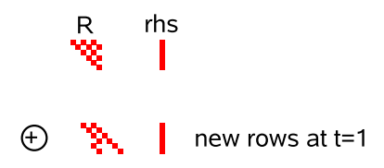
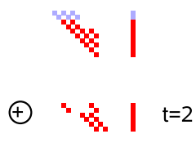
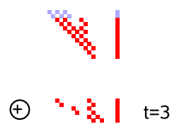
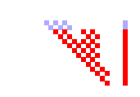
Jacobian Update
$A^{′}=\begin{matrix}A \\ w^{T}\end{matrix}$
Incrementally updating R is just more Givens rotations
Notes:
If the robot is exploring a corridor, there is no loop closure so the new measurement row will only have entries in the rightmost columns, and there will be roughly the same number of entries in each update. This means that for a corridor, the cost of updating R is constant: O(1)
A few caveats with this approach:
If the factors are nonlinear, which they usually are for SLAM, then incrementally updating the Jacobian does not relinearize about the new state, and
Whatever heuristic was initially used to choose good variable ordering was only valid for the initial matrix. As R is updated in the presence of loop closures, it suffers from fill-in
In ISAM, this is addressed by periodically relinearizing, reordering, and refactoring A.

Slide 22
Uncertainty and Data Association
Uncertainty of the state is required to perform certain common tasks
In order to match measurements to landmarks, maximum likelihood can be used:
This requires computing the Mahalanobis distance between measured position and each landmark
Need covariance on state estimate
Notes:
In general, the covariance can be found by inverting the information matrix. But that’s for suckers.
R is sparse, so as with cholesky there is a speedup. The exact recovery has O(n)-O(n^2) complexity from band-diagonal to dense matrices. R is somewhere in between

Slide 23
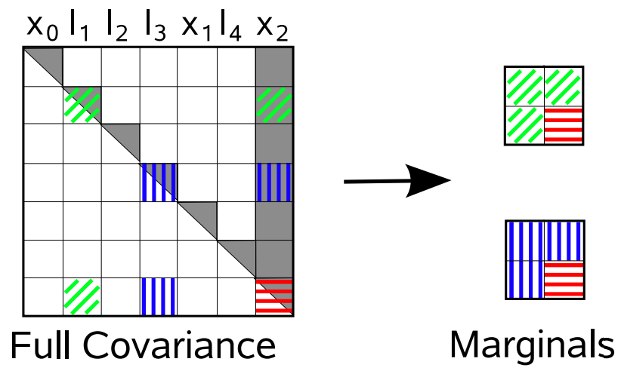
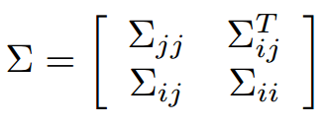
Marginal Covariance
The covariance of a subset of state variables may be all that is required
Notes:
Here, this might be to compare a measurement between x2 and l1 or l2. The maximum likelihood assignment would compare association options and pick the most likely.

Slide 24
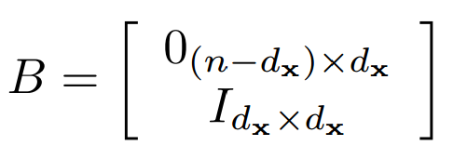
Marginal Recovery
Assuming the marginal of interest includes the rightmost variables
Last Column of Y
Notes:
This forward, backward substitution can be used to recover the rightmost column of the covariance matrix without calculating the rest of the entries
X is the last block column of covariance matrix
The last column of Y is found immediately, the remaining are back-substituted.
Assuming that the dimension of the variable of interest isn’t changing, these three parts of the marginal are recovered in constant time.

Slide 25
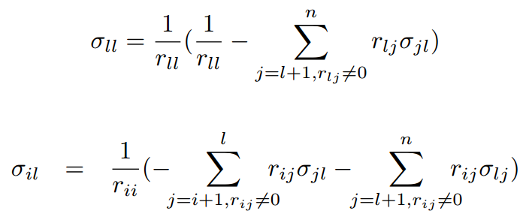
Diagonal Entries
Can recover full covariance matrix
Back-substitutions
Notes:
Isam paper presents a way to arrive at a conservative estimate for the remaining entry in the marginal covariance. It is based on the current pose uncertainty and measurement noise. With more measurements, covariance never grows, so estimating it with a single measurement is an upper bound.
For the exact method, it is similar to recovering the last column of the covariance matrix, but B is now the full square Identity matrix. Notice that only the non-zero elements of r end up adding complexity. For a dense matrix, this requires O(n^2). For a band-diagonal matrix, this is O(n). For general sparse R, somewhere in the middle.

Slide 26
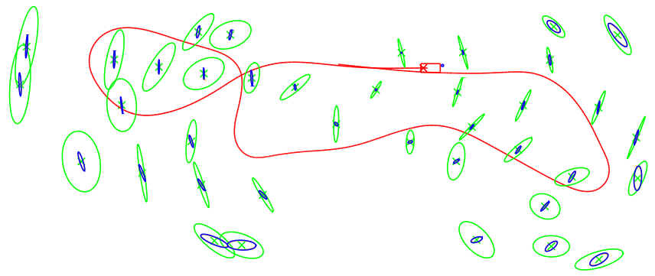
Exact Vs Approximate

Slide 27
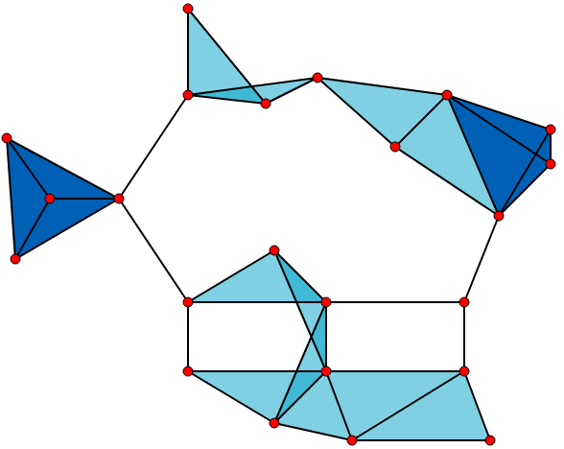
Cliques
The cliques of a graph are subsets of fully connected vertices
Notes:
Bayes tree related to clique tree related to square root information matrix
Each clique defines the conditional density over the variables of the clique, given separator variables.

Slide 28
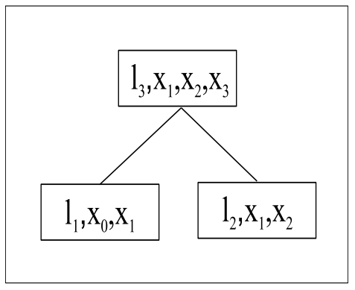
Clique Tree
The square root factor is associated with a chordal graph
Notes:
Procedure to generate clique or junction tree.
Moralize the graph (make it undirected by adding edges between all pairs of nodes that have a common child, then make all edges undirected)
Form cliques to eliminate cycles.
These trees are a decomposition used to eliminate cycles in the graph.

Slide 29
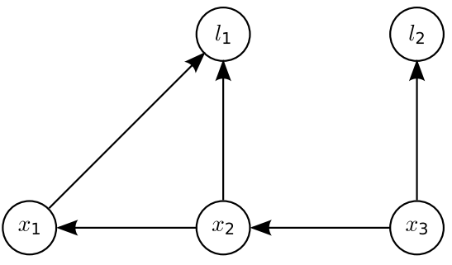
Bayes Net Again
Recall the Bayes Net
Notes:
The factors have been converted in conditionals.
Variable elimination on a Gaussian factor graph is equivalent to using QR factorization on the measurement Jacobian.
This is the basis for another incremental approach on SAM.
A Bayes tree is like a clique tree, but it is directed. Think MRF and Bayes Net.

Slide 30
Bayes Tree
A factorization of the Bayes Net
Encodes factored probability density
Cliques discovered via Maximum Cardinality Search
X2, X3
L1,X1 : X2
L2 : X3
Notes:
To find the optimal assignment for the state, can convert to Bayes tree and make one forward sweep and one backwards sweep. This is similar to the forward and backwards substitution that happens when solving with Cholesky Factorization.
The act of constructing the tree actually performs the forward substitution. The backsubstitution calculates the optimal assignment in one go starting from the root and continuing down to the leaves.
Go back a slide and do example on whiteboard

Slide 31
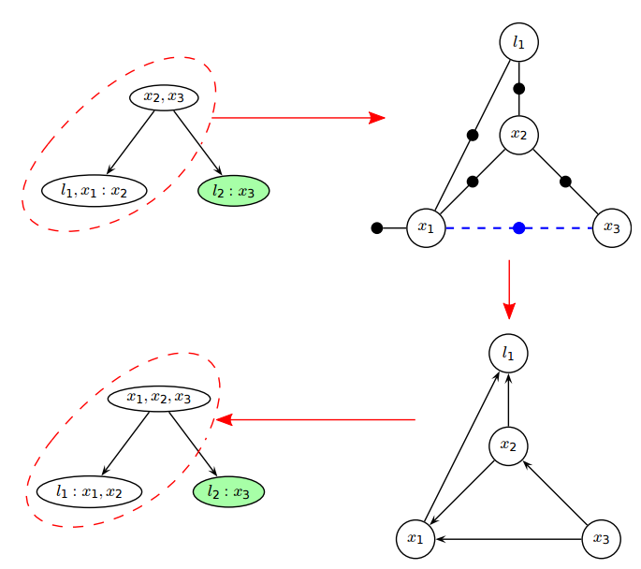
Incremental Approach - ISAM2
Bayes Tree representation can be updated incrementally
Notes:
When a new measurement factor is added, only the paths between the cliques containing the measurement variables as frontal variables and the root are affected.
That collection of cliques is then converted back into a factor graph, the new factor added to it, then converted back into a Bayes Tree. The orphaned children from the original tree are then added back on.
This is possible because the children have been conditioned on the factors affected by the updated measurements or as the paper puts it:
The Bayes tree is formed from the chordal Bayes net following the inverse elimination order. In this way, variables in each clique collect information from their child cliques via the elimination of those children. Thus, information in any clique propagates only upwards to the root. Second, the information from a factor enters elimination only when the first variable of that factor is eliminated. Combining these two properties, we see that a new factor cannot influence any other variables that are not successors of the factor’s variables.

Slide 32
Variable Ordering
During the increment, the elimination of the intermediate factor graph can be reordered
Notes:
The naïve approach is to run colAMD on each set of incremental factor graphes.
The constrained approach is to force the most recently accessed variables closer to the root.
The number of non-zero entries are the entries in the square root factor R represented by the graph.
The number of variables effected is the number of states in the updated subtree.

Slide 33
Non-Linear Factors and Partial Updates
When incorporating non-linear factors, a Taylor expansion is typically used
The process of updating Jacobians at new linearization points costs time
Only update Jacobians if needed
Similarly, defer updating states that don’t change much
Notes:
In something like an EKF, the solution found at each timestep is removed from the linearization point. This results in linearization error being baked into the prior for the next timestep.
To avoid this issue, batch methods typically relinearize about the previous estimate, and since nothing since the entire trajectory is kept, there isn’t any remaining linearization error.
When running incrementally (possibly online) though, it is advantageous to tolerate a small amount of error in exchange for a speedup. The error price is typically low due to the structure of the SLAM problem.
In ISAM2, the factors are relinearized if the state has moved a certain distance from the linearization point.
Similar idea is partial state update. Changes in the variable estimates on children do affect the root, but for much of the time, they do not have a significant effect on the root, so why bother. A Heuristic can be used to only update those estimates that change by more that a certain amount.

Slide 34
Complexity
Worst case is O(n^3) for general matrix factorization
Planar mapping with restricted sensor range is O(n^1.5)
Incremental methods can often do better most of the time
Notes:
Bound is from
http://www.cc.gatech.edu/~dellaert/ftp/Krauthausen05tr.pdf
In practice, there is a large constant factor for SLAM systems due to the front end, so these bounds only become relevant as the problem gets large.

Slide 35
Questions?

Slide 36
But What About Hard Deadlines?
Worst-case runtime is grows as the number of variables increase
If constant time is required, need another solution
Notes:
Teaser slide for tomorrow’s presentation

Slide 37
References
Course References:
K. Wu, A. Ahmed, G. A. Georgiou, and S. I. Roumeliotis, “A square root inverse filter for efficient vision-aided inertial navigation on mobile devices.,” in Robotics: Science and Systems, 2015.
M. Kaess, A. Ranganathan, and F. Dellaert, “isam: Incremental smoothing and mapping,” IEEE Transactions on Robotics, vol. 24, no. 6, pp. 1365–1378, 2008.
M. Kaess, H. Johannsson, R. Roberts, V. Ila, J. J. Leonard, and F. Dellaert, “isam2: Incremental smoothing and mapping using the bayes tree,” The International Journal of Robotics Research, vol. 31, no. 2, pp. 216–235, 2012.
Additional References:
J. Lambers, “The QR Factorization” Lecture Notes. Retrieved from http://www.math.usm.edu/lambers/mat610/sum10/lecture9.pdf
S. Thrun, Y. Liu, D. Koller, A. Ng, Z. Ghahramani, H. Durrant-Whyte. “SEIF”. Retrieved from http://robots.stanford.edu/papers/thrun.seif.pdf
F. Dellaert, M, Kaess. “Square Root SAM: Simultaneous Localization and Mapping via Square Root Information Smoothing” in The International Journal of Robotics Research, vol. 25, no. 12, pp. 1181-1203, 2006
M. Salzmann, “Some Aspects of Kalman Filtering” University of New Brunswick, August 1988
All pictures taken from these sources and wikipedia

