Slide 1
Factor Graphs and Nonlinear Least-Squares Problems on Manifolds
June 6 2017
Pranav Ganti

Slide 2
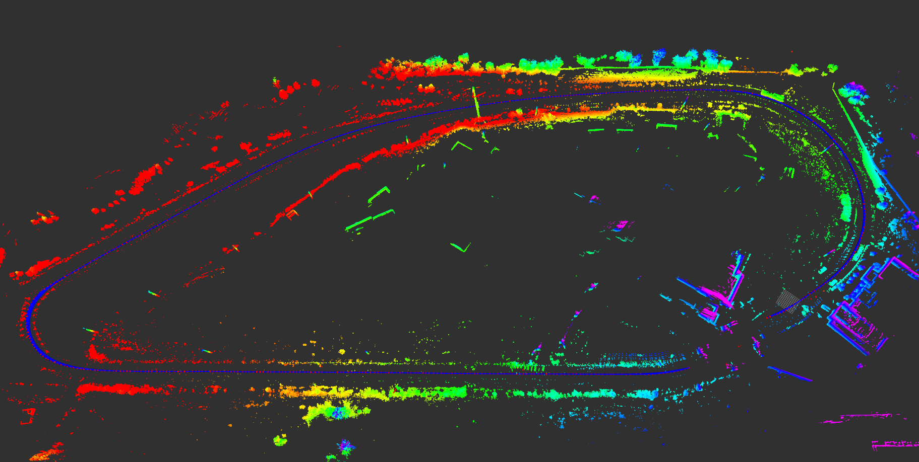
Outline
Overview
Factor Graphs
Least Squares
Nonlinear Least Squares
NLLS – extended to Manifolds!

Slide 3
Overview
SLAM is an optimization problem
Given many measurements, what is the value of the parameters we are trying to estimate?
Overdetermined system
Want to estimate the state, using the incoming measurements
Nonlinear
SE(3) or SE(2)

Slide 4
Overview | Assumptions
Independent
Previous sensory information does not affect the next reading
Identically Distributed
Sensor noise distribution is unchanged between samples
Gaussian

Slide 5
Overview | Likelihood and Posterior
Likelihood
Posterior
Notes:
Posterior dist is the probability of a random quantity, conditional on evidence. After taking relevant info into account.
Posterior is proportional to the likelihood

Slide 6
Overview | ML and MAP
ML – Maximum Likelihood
MAP – Maximum A Posteriori
Notes:
MLE is a special case of MAP, assuming a uniform prior (or ignores prior)

Slide 7
Factor Graphs
Probabilistic model which illustrates the factorization of a function
Highlights conditional dependence between random variables
Bipartite – graph has two distinct nodes
Classified into variables and factors
Connected together by edges
Excels in problems such as SLAM or SFM

Slide 8
Factor Graphs | Variables and Factors
Variables are the parameters that we are looking to optimize.
For SLAM: the robot (and landmark) poses.
Factors are probability statements
Highlight the constraints between variables (conditional dependence)
Derived from measurement or mathematical fundamentals
For SLAM: odometry, reprojection error, GPS measurements, etc.

Slide 9
Factor Graphs | Example
$x_{1}, x_{2}, x_{3}$ are robot poses over 3 time steps
$f_{0}\left(x_{1}\right)$ is the prior
Unary factor
$f_{1}, f_{2}$ are odometry measurements
Binary factor
Notes:
Unary ex. GPS
Binary ex. Lidar measurements

Slide 10
Factor Graphs | Example – Loop Closure
Notes:
SLAM is extremely dependent on correct loop closures. An incorrect correspondence can cause divergence
Factor graph does not take care of ANY of this; that’s all front end. This is effectively just the back-end optimization
However, the addition of a constraint between poses 5 and 2 will close the loop.

Slide 11
Factor graphs | Board Example
Let’s draw a factor graph with:
3 timesteps
2 landmarks
Odometry
LIDAR measurements to landmarks

Slide 12
Factor Graphs | Answer

Slide 13
Factor Graphs | Graphs vs. Value
The value of the factor graph is the product of all factors.
Maximizing the value is equivalent to the MAP estimation.
The prior is already included as a factor.
Recall:
Notes:
Discussion regarding inclusion of multiple priors vs just 1.

Slide 14
Factor Graphs | Notes
The graph describes the posterior density over the full trajectory of the robot
The graph does not contain a solution
The graph is a function, applied to the parameters
An initial guess + nonlinear least squares can be used to find the MAP estimate for the trajectory

Slide 15
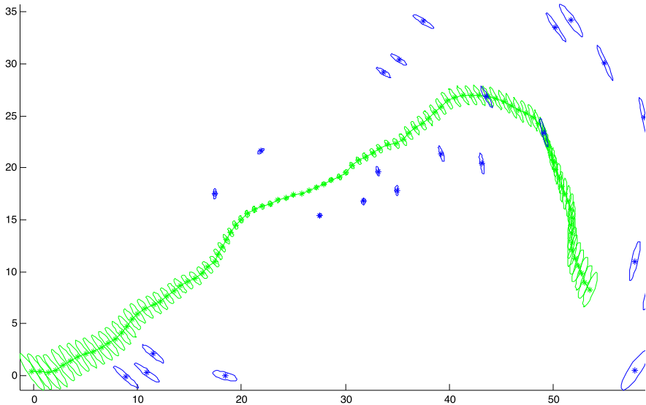
Factor Graphs | SLAM Application
The graph consists of:
100 poses
30 landmarks
Using GTSAM with an initial guess solves for the full pose estimate of the robot and landmarks
Also includes covariances

Slide 16
Factor Graphs | Example
Notes:
517 factors
119 multivariate variables
Optimizes in < 10 ms
From Victoria Park dataset

Slide 17
Factor Graphs | Batch Estimation vs. Sliding Window
Batch Estimation
Optimize over all poses in the trajectory

Slide 18
Factor Graphs | Batch Estimation vs. Sliding Window
Sliding window
Optimize only over poses in the window

Slide 19
Factor Graphs | Batch Estimation vs. Sliding Window
Sliding window
Optimize only over poses in the window
All previous information is encoded in as a prior

Slide 20
Factor Graphs | Other Applications
Visual Odometry
Pose constraints provided by tracking features
Visual SLAM
Extension of VO, to observing 3D points with mapping and loop closure
Fixed-lag Smoothing and Filtering
Recursive estimation – only require a subset of the poses
Can marginalize for online estimation
Discrete Variables and Hidden Markov Models
Notes:
Fixed –lag: only incorporates x previous poses
GTSAM specific applications

Slide 21
Least Squares
Purpose: to solve an overdetermined system of equations.
Review:

Slide 22
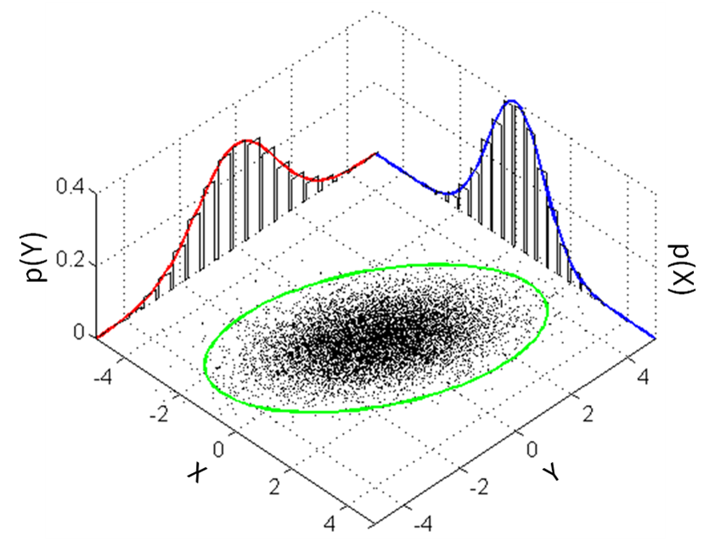
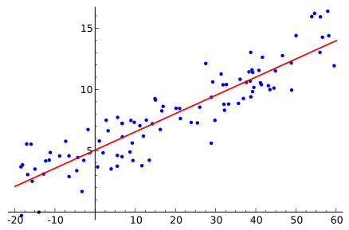
Linear vs Nonlinear Least Squares
Linear:
$y=β_{1}x+β_{2}$
$y=β_{1}x^{2}$
Nonlinear:
$y=e^{β_{1}x}$
$y=\frac{1}{\sqrt{2πΣ}}e^{\left(−\frac{1}{2}{\left(x −μ\right)}^{T}Σ^{−1}\left(x−μ\right)\right)}$

Slide 23
Nonlinear Least Squares
Not all factors are linear wrt the parameters.
Odometry, reprojection error, etc.
Main idea: linearize model about current parameters and refine
Let us work through the derivation:
Notes:
Discuss probability of measurement is Gaussian, taking ERROR means just shifting the Gaussian. Information/covariance stays the same.

Slide 24
Nonlinear Least Squares | Derivation
The measurement (and therefore error) can be expressed as (Gaussian Assumption)
Error has zero mean, with Information Matrix $Ω_{k}$
Remove the minus: (does this equation look familiar)?

Slide 25
Nonlinear Least Squares | Derivation
Let
Therefore, the argument of minimization is:
We can take the first-order Taylor Approximation of the error function
Taken about the initial guess
$J_{k}$ is the Jacobian at the guess.

Slide 26
Nonlinear Least Squares | Derivation
Inserting this into the error function yields:
Substitute error definition

Slide 27
Nonlinear Least Squares | Derivation
Multiplying the terms and expanding yields:
Which looks quite familiar!
We can solve this!

Slide 28
Nonlinear Least Squares | Derivation
The error function is the sum over all timesteps
Expressed as:

Slide 29
Nonlinear Least Squares | Derivation
The final step is to take the derivative, and set to zero.
This yields:
And the next iteration occurs at:
Until the convergence condition is met

Slide 30
Gauss-Newton and Levenberg-Marquardt
This is the Gauss-Newton algorithm.
However, sometimes Gauss-Newton can lead to worse estimates
Levenberg-Marquardt is a damped ($λ$) version of the Gauss-Newton algorithm
Introduces contingency to recover from a worse estimate
As $λ$ moves to $∞$, $Δx^{∗}$ moves to $0$
Controls size of increments

Slide 31
Structure
Both SLAM and Bundle Adjustment have a characteristic structure
Sparsity
Only non-zero between poses connected by a constraint
= 2x # of constraints + # of nodes
We can exploit this structure to solve

Slide 32
Structure | Jacobian
From:
The Jacobian $J_{k}$ can be expressed as:
Each corresponds to the derivative wrt the nodes connected by the k^{th} edge

Slide 33
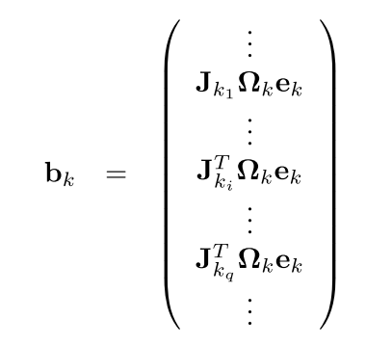
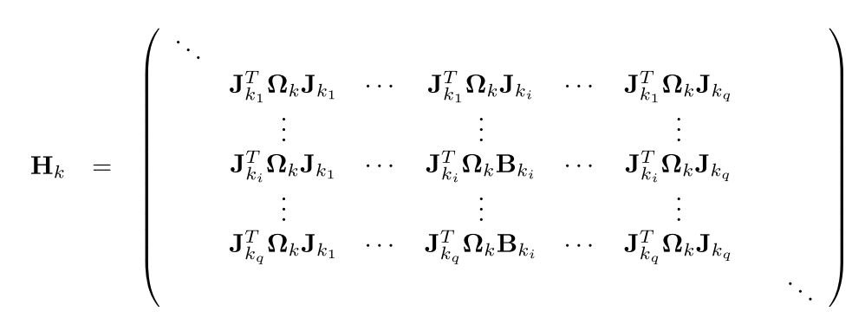
Structure | Hessian
By setting
W
s

Slide 34
Structure | Solving
This can now be solved by Sparse Cholesky Factorization
Cholesky decomposition:
Solvers:
CSparse
CHOLMOD
Preconditioned Gradient (PCG)
Only if system is too large

Slide 35
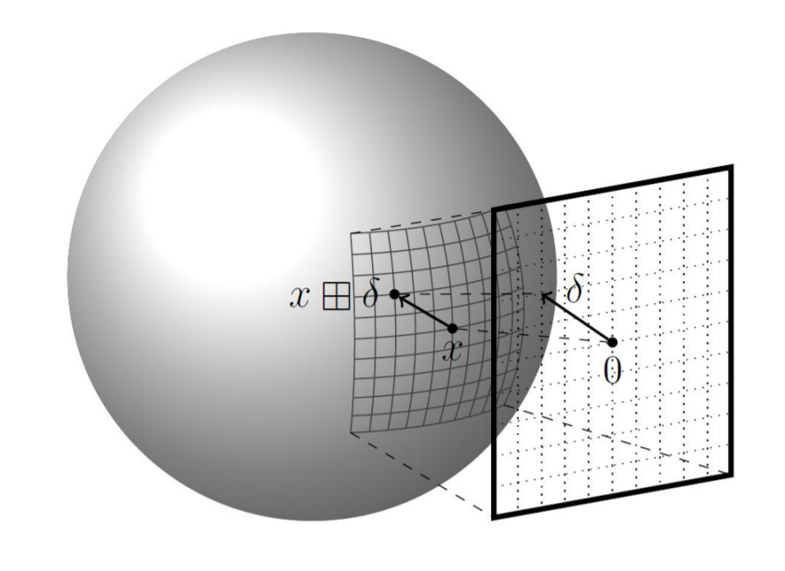
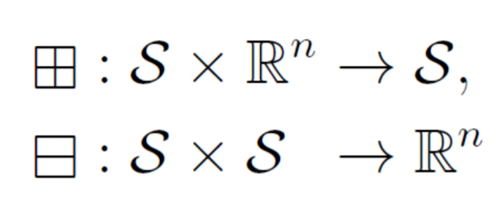
NLLS on Smooth Manifolds
The previous derivation assumes the parameters are Euclidean
Not true for SLAM
Pose estimates are SE(3)
Box-plus and box-minus

Slide 36
NLLS on Smooth Manifolds | Problem Structure
Recall: taking Taylor expansion of error near initial guess
Now, we must look at a perturbation

Slide 37
NLLS on Smooth Manifolds | Substitution
Replace addition with box plus, and subtraction with box-minus
Substitute error definition with box-plus and box-minus

Slide 38
NLLS on Smooth Manifolds | Solving
The Jacobian takes on the form:
The remaining steps are just an extension of the Euclidean derivation
Solution does depend on implementation of box-plus and box-minus

Slide 39
NLLS on Smooth Manifolds | Notes
Linearized manifold representation has the same structure as Euclidean case
Steps:
Compute set of increments in local Euclidean approximation
Libraries such as GTSAM and g²o incorporate this functionality, as they are designed for SLAM

Slide 40
Homework
Draw a factor graph with the following:
5 timesteps
6 landmarks
GPS measurements at each timestep
Odometry
IMU (at same frequency as odometry)
LIDAR measurements to each landmark
Reprojection error

Slide 41
References
Course References
[1] R. Kümmerle, G. Grisetti. H. Strasdat, K. Konolige, and W. Burgard, “g 2 o: A general framework for graph optimization,” in Robotics and Automation (ICRA), 2011 IEEE International Conference on, pp. 3607-3613, IEEE, 2011.
[2] F. Dellaert, “Factor graphs and gtsam: A hands-on introduction,” tech.rep., Georgia Institute of Technology, 2012.
Additional References
[3] M. Kaess, A. Ranganathan, and F. Dellaert, “isam: Incremental smoothing and mapping,” IEEE Transactions on Robotics, vol. 24, no. 6, pp. 1365-1378, 2008.
[4] G. Grisetti, R. Kümmerle, C. Stachniss, and W. Burgard, “A tutorial on graph-based SLAM,” IEEE Intelligent Transportation Systems Magazine, vol. 2, no. 4, pp. 31-43, 2010.
[5] G. Grisetti, “Notes on Least-Squares and SLAM DRAFT,” 2015. Retrieved from http://www.dis.uniroma1.it/~grisetti/teaching/lectures-ls-slam-master_2015_16/web/reading_material/grisetti12stest.pdf

Slide 42
References…cont
[6] C. Stachniss, “Least squares approach to SLAM.” Lecture Slides, University of Freiburg. Retrieved from http://ais.informatik.uni-freiburg.de/teaching/ws12/mapping/pdf/slam15-ls-slam.pdf
[7] W. Burgard, C. Stachniss, K. Arras, M. Bennewitz, “Advanced Techniques for Mobile Robotics – Least Squares.” Lecture Slides, University of Freiburg. Retrieved from http://ais.informatik.uni-freiburg.de/teaching/ws11/robotics2/pdfs/rob2-06-least-squares.pdf.
All images retrieved from wikipedia.org.

