Slide 1
Modeling Absolute and Relative pose residual terms, point-cloud scan registration
June 27, 2017
Benjamin Skikos

Slide 2
Outline
Modeling Representation
Relative
Jacobian example from bundle adjustment
Point Set Registration
Categories
Popular/Interesting algorithms
Application-specific example

Slide 3
Relative Graph Representation
The poses in the graph are positioned relative to each other
Each landmark is positioned wrt the first pose that observed it
Notes:
Reminiscent of transform trees.
This is taken from Sibley’s Relative Bundle Adjustment.
This is in contrast to the usually formulation in which there is a single unified Euclidean frame.
Riemannian manifold:
It’s SE(3) but with the understanding that there is a metric on the tangent space at the identity that can be extended to
The whole group by left translation. Invariant to change in the inertial reference frame. This operation is defined to be
SE(3)xM -> M where M is some manifold
http://maths-people.anu.edu.au/~andrews/DG/DG_chap9.pdf
A topological space is connected if
It cannot be expressed as a disjoint union of two nonempty open subsets
It cannot be expressed as a disjoint union of two nonempty closed subsets
It cannot be expressed as a union of a collection of pairwise disjoint nonempty open subsets that has size more than one
it cannot be expressed as a union of a collection of finitely many pairwise disjoint nonempty closed subsets that has size more than one.
The only clopen subsets of the space are the whole space and the empty subset
https://topospaces.subwiki.org/wiki/Connected_space
So pretty much what intuition would suggest

Slide 4
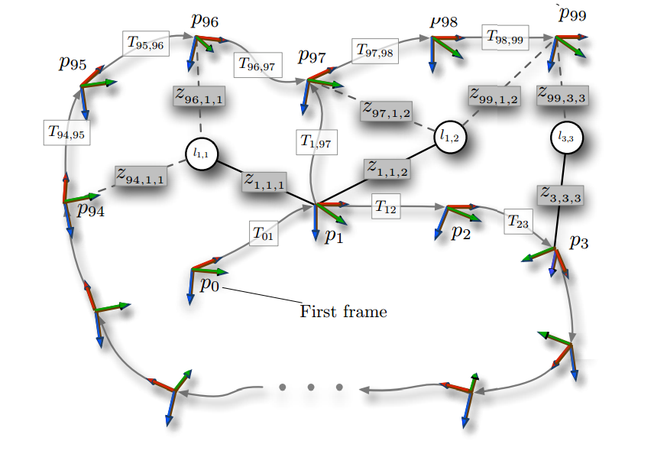
Estimation States in a Relative Graph
Notes:
So this paper relative bundle adjustment is about doing bundle adjustment on a 6 dimensional Riemannian manifold with a distance metric based on shortest paths. They argue that doing the estimation on this metric manifold instead of a single Euclidean coordinate frame constant time incremental updates can be achieved even with loop closure.
The caveat is that projecting from this relative solution to a single Euclidean space is “a difficult problem that we argue is best handled by external resources that do not have constant run-time requirements”
The problem is structured as a graph of relative poses with landmarks specified in relation to these poses. Each of the m poses is a 6 element vector that defines an element in SE3 that represents a transform from a base frame to the child frame (the element). Similarly each of the n landmarks is defined as a point in some base-frame. There are m-1 estimates (along the vehicle path) + any loop closing contraints. Each is defined as an error-state 6 vector, in other words, the error between the estimated relative transform and the optimized version. The concatenation of these error-state vectors is the state.

Slide 5
Relative Jacobians (For Cameras)
Notes:
H is the measurement model
Gijk transforms the landmark to the observation frame i
M 4x3 transforms a point from the vehicle frame I to the sensor frame s and projects from homogenous to Euclidean.
K is the camera calibration matrix that projects the point from R3 -> R2
J is the objective function to minimize. R is the covariance of the measurement

Slide 6
Kinematic Chain
Notes:
This is an example of transforming along the relative coordinates. Here, only one error estimate is explicitly shown, but each transform carries its own small error transform.

Slide 7
Transform Jacobian
Recall 2nd presentation
Notes:
Gijk transforms landmark k, stored relative to base-frame j to the observation frame I
Lck is the point ljk transferred to frame c
[]x is the map from a 3 vector to the skew symmetric matrix
This jacobian is 4x6 since tc is a 6 vector (xyzrpy)

Slide 8
Calibration Matrix Jacobian
Notes:
K is the projective function. It is non-linear due to the scaling operation, so it is non-trivial.

Slide 9
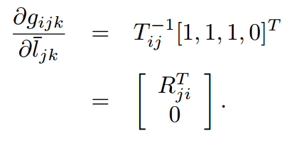
Linear Jacobians
Notes:
These ones are linear, so nice and easy

Slide 10
All Together
Notice presence of Kinematic Chains in each measurement
Landmark
Transform Estimates

Slide 11
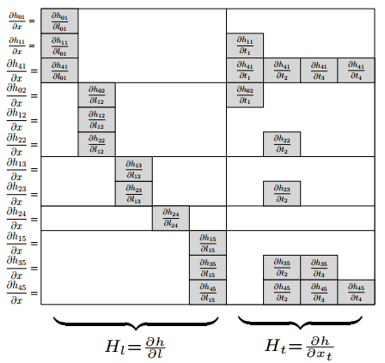
Absolute Vs Relative
Notes:
The normal equation there is for one iteration of gauss newton
Paraphrasing, the only difference in the sparsity pattern of the measurement Jacobian between the absolute and relative measurement Jacobians is the addition of bands along the kinematic chain of the measurement. However, if all the poses that observe the feature are contiguous, then

Slide 12
Trade-offs
Relative formulation allows natural partial state updates
Converting relative estimates into a unified coordinate system is expensive
Notes:
So we now have a relative formulation. What does it get us? A less-sparse Jacobian, great. So why do it?
It makes for a more natural incremental approach.

Slide 13
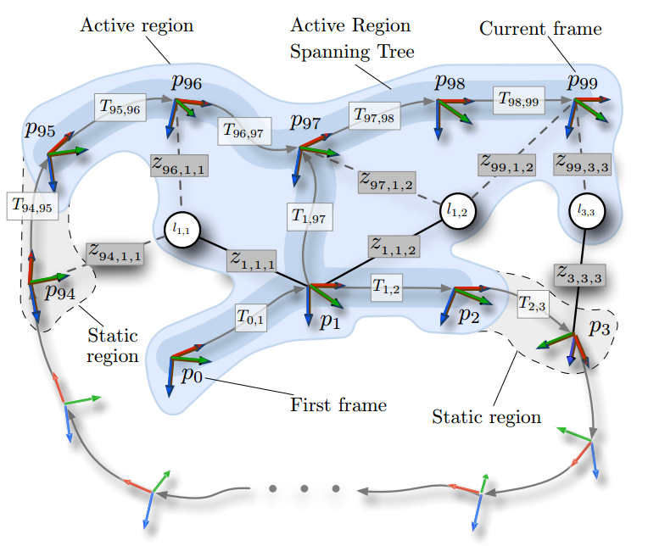
Partial Update
Notes:
In this scheme, during the first optimization iteration, only frames in which the average reprojection error changes by some amount are added to the active region (which is grown by a breadth-first search starting at the most recent frame).
This limits the number of frames active even during loop closure, because the other side of the loop’s relative positioning does not change.

Slide 14
Questions?

Slide 15
Scan Registration Categories
Overall Goal: Find the displacement between two sets of points
Plenty of variation in the problem formation
Dimensionality
Rigid Non-Rigid
Point-level
Notes:
So in general, these formulations seeks to find a single rotation and translation that minimizes some cost.

Slide 16
Rigid/Non-Rigid
A rigid transform preserves distance between points
Static environment
No motion-distortion
A non-rigid transform does not
Useful in non-static environments
Objective function designed to impose constraints on stretch
More expensive
Notes:
Rotating laser scanners suffer from an extreme form of rolling shutter. Compared to a cameras taking a frame, it takes much longer for a 360° laser scanner.
Non-rigid registration is an active area of research in computer vision. A notable application being medical imaging. It is easy to imagine someone’s body deforming as they pump blood, breath, etc. but you still want to combine images together to say, build a 3d model of their tumour or something.

Slide 17
Iterative Closest Point
This is a rigid, direct algorithm
Cost function minimizes sum of squared distance be correspondences
Closed form solution exists, based on maximizing cross-correlation
Notes:
ICP introduced (more or less) by Besl McKay in 1992
For symbols, f(q) in the cost function, Np in the number of corresponding points in each cloud (the indices line up). Xi is a point in the reference scan. Qr is the quaternion part of q. Qt is the translation part of q. R(qr) is the rotation matrix with corresponding quaternion. And pi is a point in the scan trying to be aligned.
Cost is dominated by finding correspondences at each iteration of the algorithm.
This algorithm actually inspired a whole “class” of ICP-like PSR algorithms that extend ICP
Of those algorithms that operate directly on the points, this one remains popular because it is simply and lightweight.

Slide 18
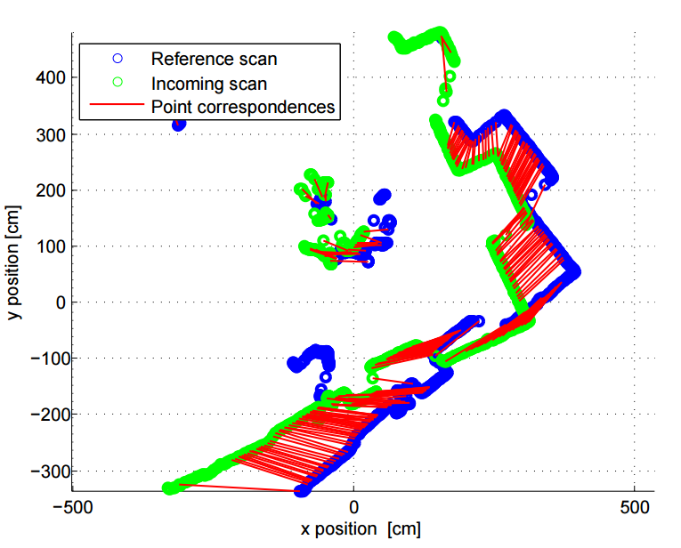
ICP Example
Notes:
The correspondences shown are the final correspondences

Slide 19
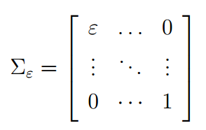
Generalized - ICP
Instead of point-to-point distance, uses plane-to-plane
Surface normals are extracted using PCA in local neighbourhoods
Cost function based on maximum likelihood using covariance matrices
Notes:
One of the pitfalls of ICP is that it is greatly affected by point density. Some extensions try to reduce that effect by changing
The objective function. In generalized ICP, an assumption is made about the structure of the environment: it is locally planar.
Think of it like lining up two discs, the covariance matrix associated with each point is like a pancake.
http://citeseerx.ist.psu.edu/viewdoc/download?doi=10.1.1.149.3870&rep=rep1&type=pdf
Generalized ICP paper.
Di is the distance between points based on current transform parameters
CiB and CiA are the covariance matrices of each point assuming that they are on a plane.
They are each that matrix with eplison (small value) rotated st eplison is along surface normal.

Slide 20
Appearance of Covariance Matrices
Notes:
If epsilon is constant, the flatness does not change from point to point.

Slide 21
Normal Distributions Transform W/Grids
The reference scan is subdivided into cells
The surface within each cell is modelled as Gaussian
Notes:
With normal distributions transform matching, the reference point set is first converted into a set of Gaussian distributions based on sample mean and covariance. Simplest approach is to discretize the space into voxels and produce a Gaussian within each voxel. Other approaches are based on clustering, you could adjust the cluster sizes to get a coarse to fine refinement.
Downsides are that the correspondence between points (or distributions) to distributions is still up to initialization (nearest neighbour) and that at the boundary between neighbouring Gaussians the cost can be non-smooth. An approach that can be taken is to use include the closest k distributions in the cost function, but at additional complexity.

Slide 22
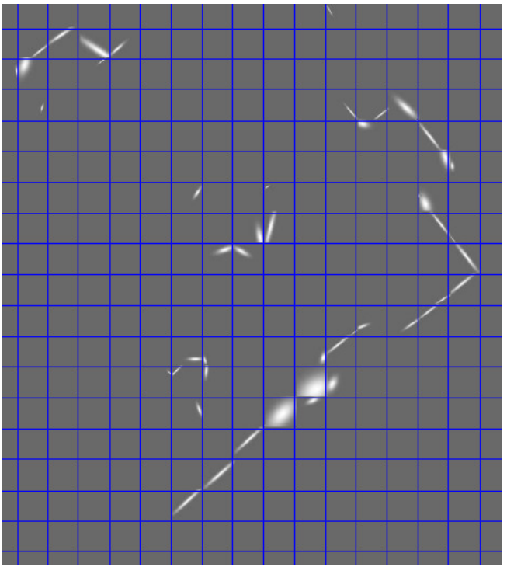
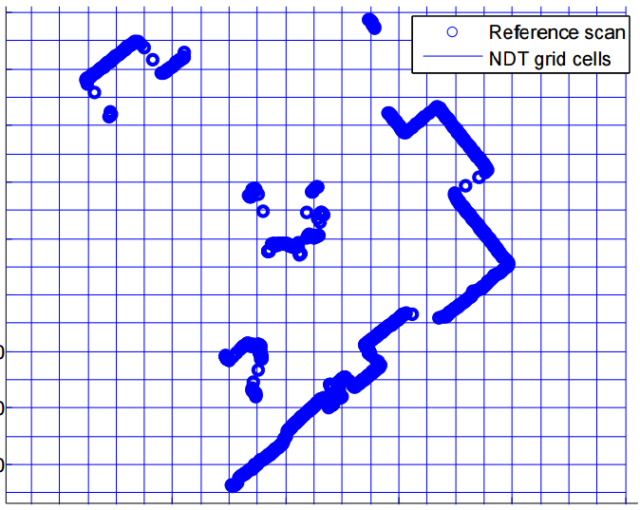
NDT Transformation Visual
Notes:
Figure on right is a visualization of the probability distribution
Note the discontinuous nature at the boundary of the cells.

Slide 23
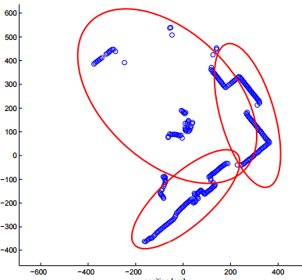
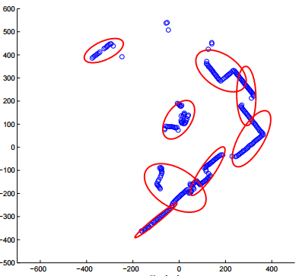
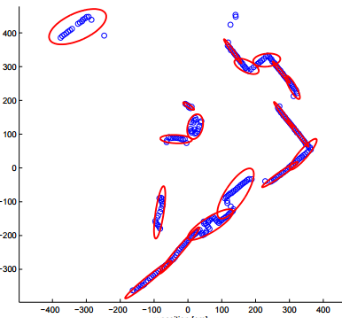
NDT Subdivision
Subdivision strategies are independent
Notes:
This is an example of k means clustering applied with different scales. The algorithm these images uses them all to perform a coarse to fine scan registration refinement to improve convergence properties

Slide 24
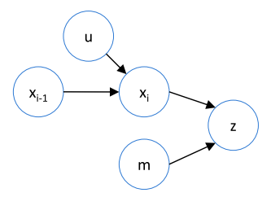
Correlative Scan Matching I
Maximize
Notes:
Actually kind of similar to NDT in that the reference scan is used to generate a probability distribution. Except in this case the probability distribution is a discrete lookup table.
Z are the measurements
Xi is the current state
U is the input to the motion model
M is the environment model

Slide 25
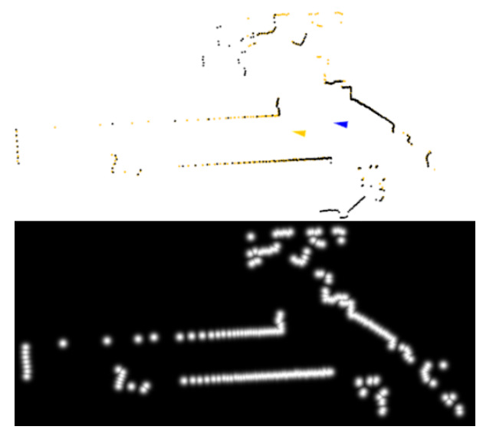
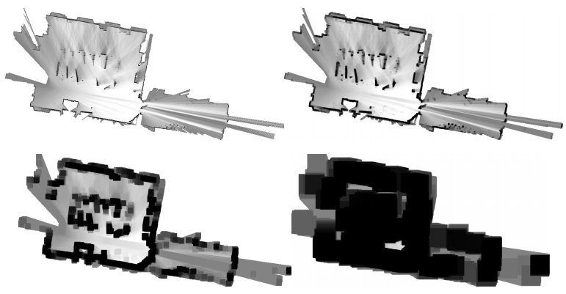
Correlative Scan Matching II
Notes:
This distribution is approximated by a lookup table
Lends itself to a multiresolution approach. Starting from a low resolution version of the map. Angular parameters are iterated over a search window and the optimal displacement for that resolution is found. That rotation is then used to search higher resolution grids.
Image on left is from Ed Olson’s original paper. The one on the right is from Google Cartographer paper.
Steps from Olson
Evaluate the probability p(z|xi , m) over the entire 3D search window using the low-resolution table.
Find the best voxel in the low-resolution 3D space that has not already been considered. Denote this value as Li . If Li < Hbest, terminate: Hbest is the best scan matching alignment.
Evaluate the search volume inside voxel i using the high resolution table. Suppose the log-likelihood of this voxel is Hi . Note that Hi ≤ Li since the low-resolution map overestimates the log likelihoods. If Hi > Hbest, set Hbest = Hi .

Slide 26
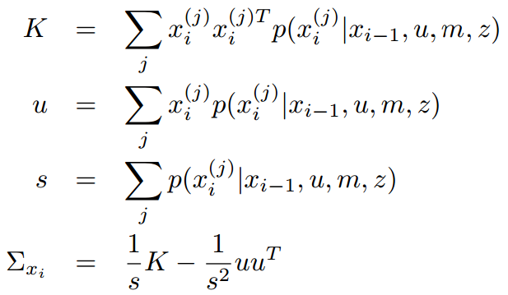
Correlative Scan Matching Uncertainty
By sampling the cost function, a Gaussian distribution can be fit to the results
Notes:
It is not perfect because only a local window is searched.

Slide 27
Correlative Scan Matching Covariance
Notes:
But can still capture hallway issue well.

Slide 28
Uncertainty In General
For local search methods, the only real-time feasible way to estimate covariance is via their cost function
Andresi Censi has a good example of a general method that can be applied to any cost function (in that case ICP)
Notes:
Censi displays a neat way to incorporate sensor uncertainty, but the estimate is still mostly based on the Jacobian of the cost function. This is a problem for some methods like ICP who’s cost function does not reflect certain geometric degeneracies due to changing correspondences.

Slide 29
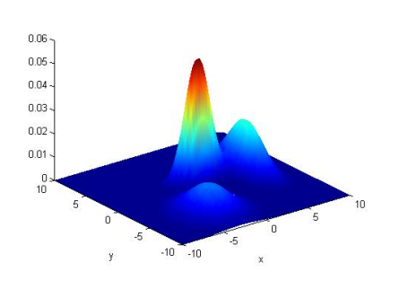
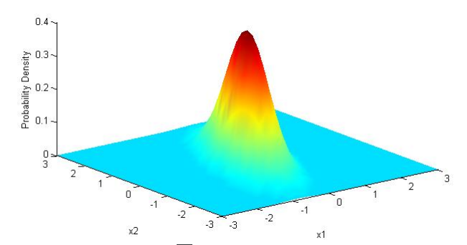
Gaussian Mixture Model
Mixture model is a distribution formed from a mixture of other distributions
Notes:
Mixture models don’t have to be formed from Gaussian, but since Gaussian is the most familiar
http://www.computerrobotvision.org/2010/tutorial_day/GMM_said_crv10_tutorial.pdf
Fine, but how to fit a GMM to some data?
-Multiple approaches, but expectation-maximization is a popular one.

Slide 30
Coherent Point Drift – Non Rigid Algorithm
Align point sets with a coherent velocity field
Notes:
Given to point sets,
Fit a GMM to the first point set, whose centroids (means) are the points in the second set.
There are hyperparameters controlling Gaussian components

Slide 31
Coherent Point Drift Formulation
Point sets:
Each point in Y is taken as a centroid for a GMM
That model is fit to the point in X by maximizing the likelihood
Notes:
V is a smooth velocity function
That last term is a regularization term on Y. That function will be chosen to enforce a smooth motion constraint

Slide 32
CPD - Smooth Motion Function
For CPD, the smooth motion is imposed by penalizing the high frequency energy of the velocity function
Accordingly, G is a symmetric low-pass filter
Notes:
Tilde indicate the Fourier transform. G is some kind of low pass filter that tends to 0 as |s| -> infinity. Effectively high-passes the velocity field energy so that only the high frequency components are penalized.

Slide 33
CPD - Velocity Function
Can be shown that function that minimizes energy is
Where G is a Gaussian Kernel
Notes:
I encourage you to review the appendix of the coherent motion drift paper for the derivation of the minimizing smoothing function.
A Gaussian low pass filter has the Gaussian form in both frequency and time domain. This can be shown by using the definition of the Fourier transform and Euler’s identity.

Slide 34
CPD – Expectation-Maximization
An upper bound on the cost function is
C. M. CBishop. Neural Networks for Pattern Recognition. Oxford University Press, Inc., 1995.
Notes:
See book for derivation.
The term on the bottom is added to the denominator in order to add in a uniform prior to explicitly account for points that have no correspondence. Decreasing a increases the strength of the uniform prior.

Slide 35
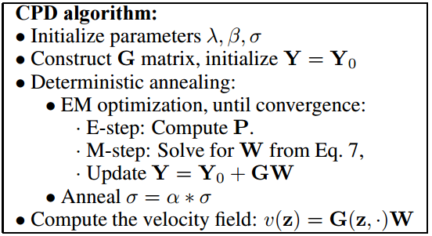
CPD – Expectation-Maximization II
Can minimize upper bound wrt W
Notes:
This finishes the derivation and summarizes CPD. The deterministic annealing step reduces the variance of the GMM to get a coarse to fine refinement effect.
The initialized parameters are
Lambda, This controls how smooth the resulting velocity field is constrained to be
Beta, This is the “hyper-parameter” of the Gaussian kernel. The larger the value the greater the interaction between neighbouring sets of points
Sigma, Initial variance for the GMM
Alpha, annealing rate

Slide 36
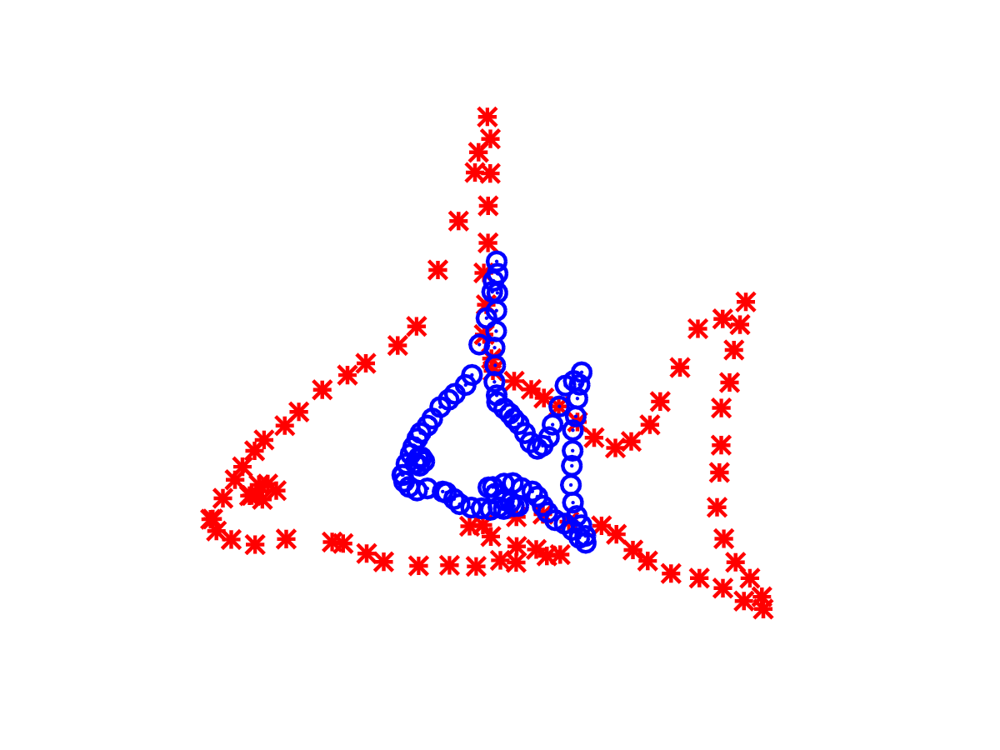
CPD Example Match
https://en.wikipedia.org/wiki/Point_set_registration#/media/File:Cpd_fish_affine.gif

Slide 37
Practical Considerations
Motion distortion (similar to rolling shutter)
Ansiotropic resolution
Real-time constraint
Quality Estimate
Notes:
The laser scanner we use, HDL-32e has highly anisotropic resolution. Methods that use points directly like ICP are effected by pointcloud density, and hence are negatively affected by this sparseness. Consider a velodyne scan taken in the middle of a large flat area; It will consist of a number of circular rings where the laser is sampling the ground. The appearance of the scan does not change depending on where you are on the flat surface, but depending on how it is initialized ICP may estimate no movement at all, and worse still be overconfident in the result!

Slide 38
Specialized Example (LOAM)
IMU is integrated (or VO is used) to produce an estimate for the non-constant velocity (during a scan)
Lidar feature-matching used to find constant velocity component
Assuming IMU biases (or VO drift) are slowly changing, scan-matching will correct
Notes:
Neat hierarchical approach. Gist is to use high frequency sensors down to low-frequency sensors.

Slide 39
LOAM Lidar Features
Designed to pick up edges and planes

Slide 40
Cost Function
Made up of distance terms
Depending on feature type, point to line distance or point to plane distance

Slide 41
Questions?
Notes:
Experimental results? Hopefully.

Slide 42
References
G. Sibley, “Relative bundle adjustment,” 2009.
A. Das, “Scan registration using the normal distributions transform and point cloud clustering techniques,” 2013.
E. Olson, “Real-time Correlative Scan Matching”, 2009
W. Hess et Al, “Real-Time Loop Closure in 2D Lidar SLAM”, 2016
A. Myronenko et al, “Non-rigid point set registration: Coherent Point Drift”, 2006
J. Zhange, S. Singh, “LOAM: Lidar Odometry and Mapping in Real-Time”, 2014

