Slide 1
Homework |
Determine the Maximum Likelihood Estimator for the mean and variance of a Gaussian Distribution
Jason Rebello | Waterloo Autonomous Vehicles Lab

Slide 2
Homework|
Show that these two forms of the CRLB are equivalent
Arun Das | Waterloo Autonomous Vehicles Lab

Slide 3
Homework
Draw a factor graph with the following:
5 timesteps
6 landmarks
GPS measurements at each timestep
Odometry
IMU (at same frequency as odometry)
LIDAR measurements to each landmark
Reprojection error

Slide 4
Homework
Take the factor graph created from the previous slide and convert it to a Bayes tree (pages 5 and 6 in ISAM2 paper good reference))

Slide 5
Marginalization and sliding window| Homework
Homework problem #1 (easy)
Answer questions 3-5 from “The humble Gaussian distribution”
Mackay, David. “The humble Gaussian distribution,” 2006.

Slide 6
Marginalization and sliding window| Homework
Homework problem #1 (easy)
Answer questions 3-5 from “The humble Gaussian distribution”
Mackay, David. “The humble Gaussian distribution,” 2006.

Slide 7
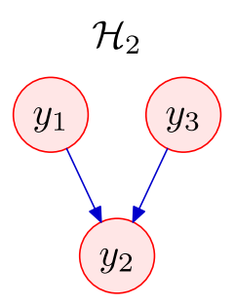
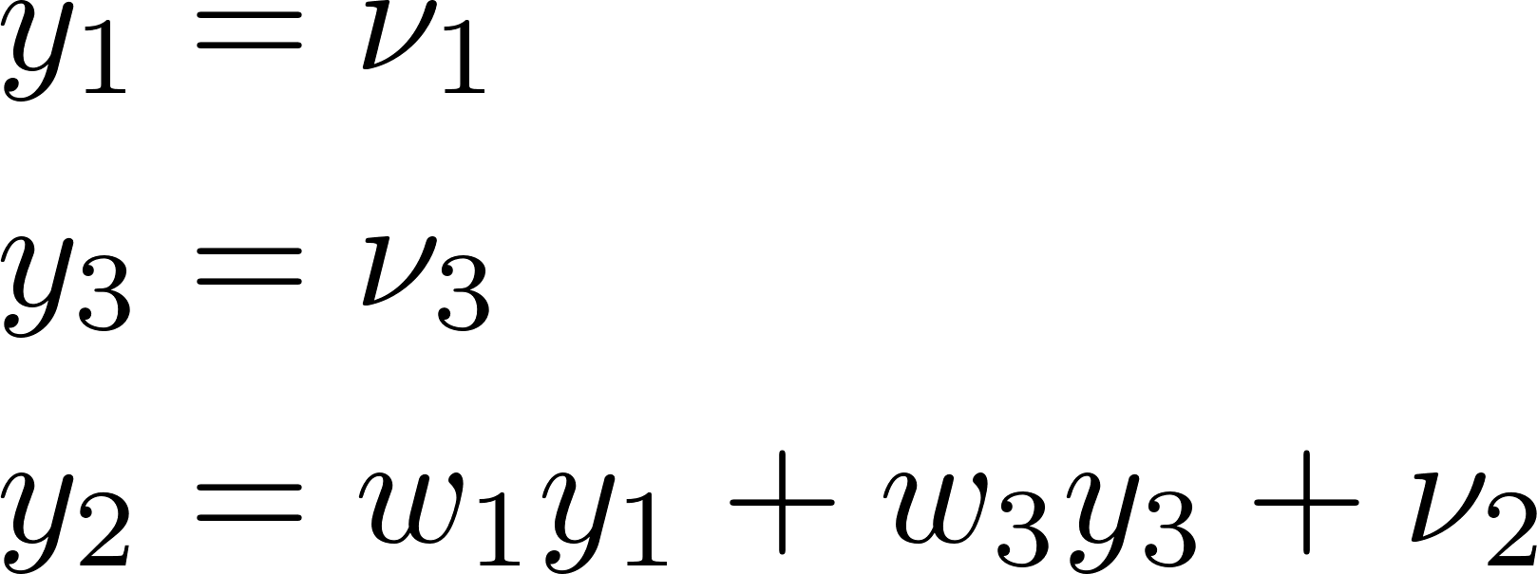
Marginalization and sliding window| Homework
Homework problem #2 (hard)
Consider Example 2 from “The humble Gaussian distribution”:
a) Find the covariance and inverse covariance matrix
b) Marginalize out y₁ in each form
Mackay, David. “The humble Gaussian distribution,” 2006.

